Slide 1

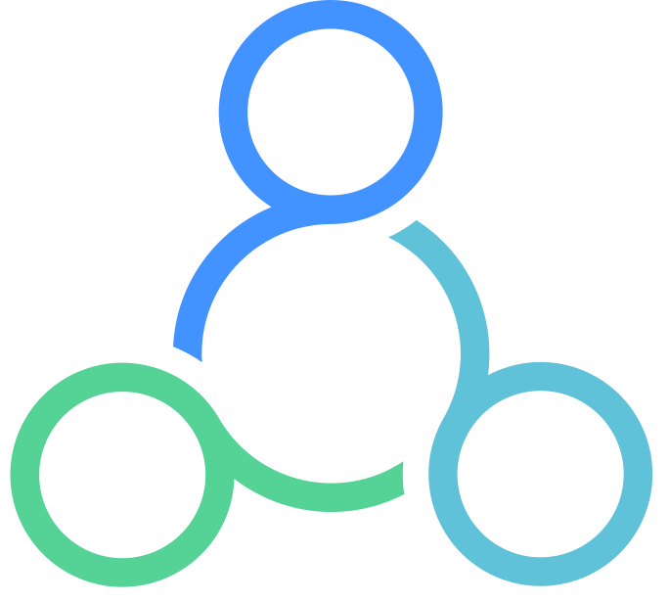




Smart Steward Method
™
*Free resources from this session at donordock.com

Slide 2
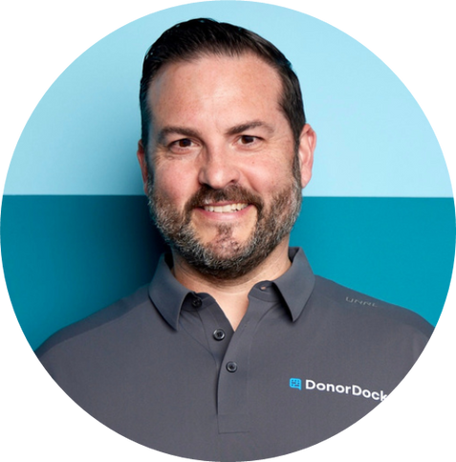
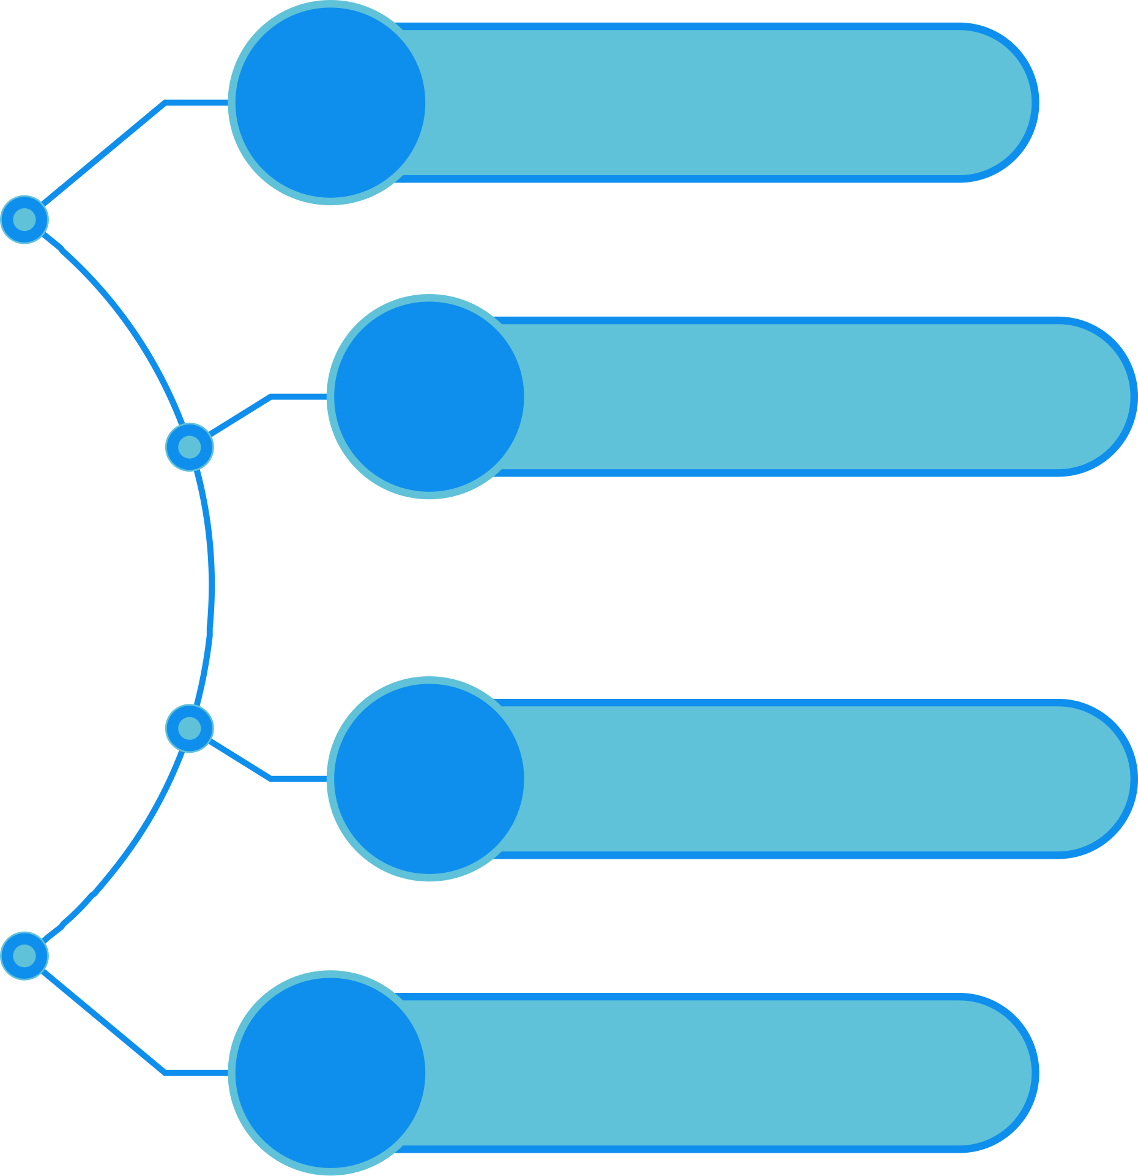
INTRODUCTION
Why donor stewardship?
Smart Steward
Method
Agenda
Matt Bitzegaio
Stewardship Journeys
Co-Founder & CEO
Getting Started

Slide 3
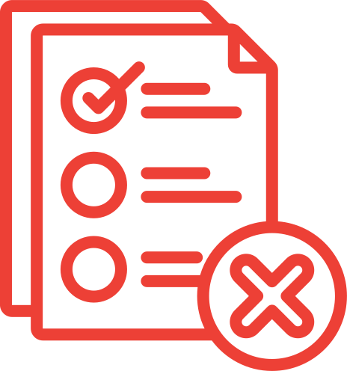


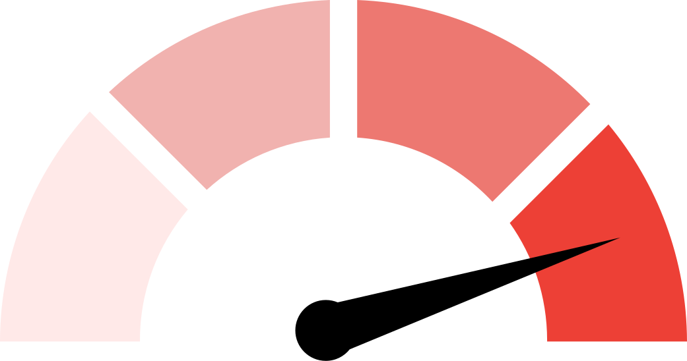
Challenges
The “Should” list keeps growing
Managing disconnected tools & data
Donor expectations don’t match the experience
Limited budget, time, and resources

Slide 4




Solution
Smart Steward Method
An iterative approach to building and nurturing relationships, using data-driven insights and timely actions to create meaningful, lasting connections.
Productivity
Confidence
Experience
Be more productive and know what to do every day
Be confident knowing the work you are doing is making a difference
Align your donor’s experience with their expectations even as you grow

Slide 5
EVALUATE
Assess current practices

Slide 6

What is our reality today?
Questions
How do you currently segment your contacts?
Do you have a cultivation process for prospective donors?
How do you acknowledge first-time donors?
How do you communicate with recurring donors?
Do you have a mid-level giving program?
Do you have a defined process for stewarding major donors?
Do you have a plan for re-engaging lapsed donors?

Slide 7
ESTABLISH
Define Journeys

Slide 8
Journeys
What are journeys?
The journeys are the intentional, step‑by‑step experiences an individual has with your organization—from first awareness of the mission, through initial gift, deeper engagement, and ultimately long‑term advocacy.

Slide 9
Journeys
Goals of journeys
  Consistent, personalized touchpoints build trust and momentum.
  A predictable, well‑timed journey makes supporters feel seen, appreciated, and confident their gifts matter.
  With predefined journeys, staff know exactly when to automate versus when the time is right for personal connection.
  Repeatability - when we follow a defined process we can measure and improve, and create repeatable outcomes!

Slide 10

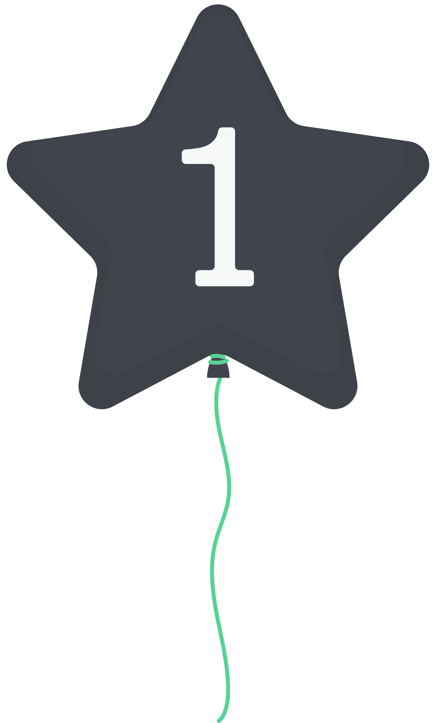

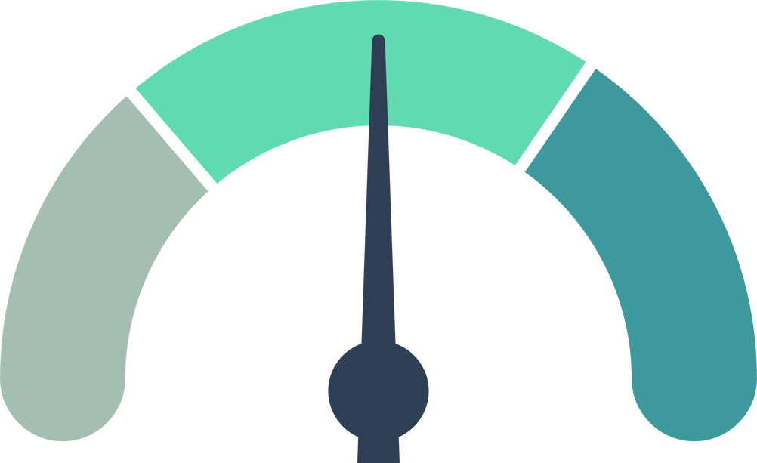
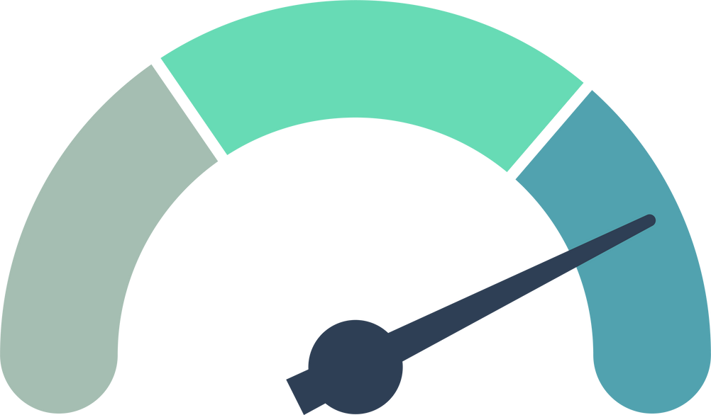

Key Stewardship Journeys
PROSPECT
FIRST-TIME DONOR
RECURRING DONOR
MID-LEVEL DONOR
MAJOR DONOR
LAPSED

Slide 11
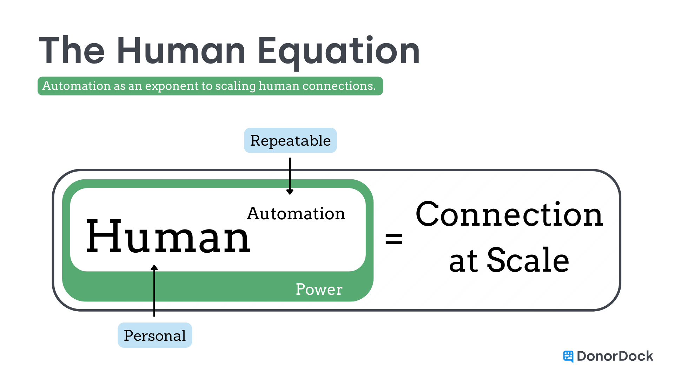

Slide 12
Key Stewardship Journeys
PROSPECT

Slide 13
Prospect Journey Signals
We typically can’t, and don’t want to, put every contact in our database into a prospect journey!

Slide 14
Prospect Journey Signals
We typically can’t, and don’t want to, put every contact in our database into a prospect journey!
Journeys have a cost - they take time and resources. Pouring low‑probability names into the funnel eats budget and hours that could be spent deepening relationships with the best candidates, driving down your return on fundraising investment.

Slide 15
Prospect Journey Signals
So what are some signals that someone is a good candidate?

Slide 16
Prospect Journey Signals
So what are some signals that someone is a good candidate?
  Responding to communication

Slide 17
Prospect Journey Signals
So what are some signals that someone is a good candidate?
  Responding to communication
  Event attendance

Slide 18
Prospect Journey Signals
So what are some signals that someone is a good candidate?
  Responding to communication
  Event attendance
  Expressed interest or passion

Slide 19
Prospect Journey Signals
So what are some signals that someone is a good candidate?
  Responding to communication
  Event attendance
  Expressed interest or passion
  Website interaction

Slide 20
Prospect Journey Signals
So what are some signals that someone is a good candidate?
  Responding to communication
  Event attendance
  Expressed interest or passion
  Website interaction
  Social media engagement

Slide 21
Prospect Journey Signals
So what are some signals that someone is a good candidate?
  Responding to communication
  Event attendance
  Expressed interest or passion
  Website interaction
  Social media engagement
  Referrals or peer recommendations

Slide 22
Prospect Journey Signals
So what are some signals that someone is a good candidate?
  Responding to communication
  Event attendance
  Expressed interest or passion
  Website interaction
  Social media engagement
  Referrals or peer recommendations
  Community reputation or influence

Slide 23
Prospect Journey
Identification
& Lead Capture
Introductory Outreach
(Mission Awareness)
Mission-Focused Nurture & Storytelling
Soft Ask
for First Gift
Final Follow-Up or Alternate Engagement Offer
Day 1
Day 7
Day 45
Day 60
Day 120
  Basic Profile & Segmentation
  Gather any available info: email address, interests (if indicated), location, etc.
  Welcome Email or Mailer
  Low-Pressure Engagement
  Deep Dive Content
  Community Invitation
  Offer a light invitation to get more involved—e.g., attend a virtual info session, open house, volunteer opportunity, etc..
  Personalized Communication
  Tangible Impact Statement
  Gentle Reminder
  Offer Other Ways to Engage

Slide 24
Key Stewardship Journeys
PROSPECT
FIRST-TIME DONOR

Slide 25
First Time Donor Journey
Immediate Acknowledgment & Gratitude
Personalized “Welcome to Our Mission” Communication
Share a Success Story or Behind-the-Scenes Look
Invitation to Engage Further
Recap & Second Gift (or Recurring Gift) Invitation
Day 1
Day 6
Day 14
Day 30
Day 60
  Automated email thank you
  Personal thank you and welcome
  Welcome Email or Direct Mail
  Share a quick overview of your organization’s story, vision, and key programs.
  Impact-Focused Content: Send an email or letter that highlights a recent success story, beneficiary testimonial, or behind-the-scenes look at how you operate.
  Personal Touchpoint - share appreciation
  Invite to event
  Emphasize that attending an event or volunteering is as important as financial support.
  Impact Recap: Summarize what’s been accomplished since their first gift
  Suggest a second one-time gift or encourage them to consider recurring giving.

Slide 26
Key Stewardship Journeys
PROSPECT
FIRST-TIME DONOR
RECURRING DONOR

Slide 27
Recurring Donor Journey
Enrollment & Immediate
Gratitude
Personal Touch
& Mission
Integration
First Milestone Check-In
Midpoint Stewardship & Soft Upgrade Invite
Deeper Engagement & Community Building
12-Month Anniversary Celebration
Day 1
Day 6
Month 3
Month 6
Month 9
Month 12
  Send an automated email or letter confirming their enrollment
  Clearly state how monthly gifts create stability
  Provide a tangible example (e.g., “Each month, you help us feed 10 children”)
  Email, phone call, or postcard that explicitly thanks them again for choosing to donate monthly
  If possible, mention their first month’s gift was put to immediate use (brief example if you have one)
  Send an email or letter highlighting what monthly gifts have collectively accomplished in the last quarter
  Personal Connection (Optional) - Phone call, text, meeting
  Send a “6-Month Thank You” email or letter
  Include a gentle suggestion to consider increasing their monthly amount
  Send exclusive content or event invite
  Send a thank you and reinforce their value
  One-Year Anniversary Thank-You
  Renew or Upgrade Invitation
  Personal Call or Note (Optional, if feasible)

Slide 28
Key Stewardship Journeys
PROSPECT
FIRST-TIME DONOR
RECURRING DONOR
MID-LEVEL DONOR

Slide 29
Mid-Level Donor Journey
Identification & Personal Acknowledgment
Introductory Touchpoint & Mission Alignment
Deeper
Engagement & Impact Showcase
Exclusive Event or Insider Access
Potential Upgrade or Next-Level Involvement
Annual Check-In & Renewal
Day 1
Day 7
Month 2
Month 4
Month 7
Month 12
  “Welcome to Mid-Level” Personalized Thank-You
  Introduce a Point of Contact - “Name a specific staff member or development officer who will be their go-to for questions or updates.”
  Personal Outreach - A short call, handwritten note, or personalized email
  Mission Overview or Impact Report - highlight where mid-level donors have specific influence.
  Share a Success Story or Program Update
  Invite Feedback or Questions
  Invite to a Special Event/Briefing
  Show Tangible ROI
  Point out exactly what donor contributions have funded.
  Spotlighting the donor’s impact.
  Check-In Call or Email
  Soft Ask or Upgrade Conversation
  If donor engagement is strong (attending events, responding to emails), consider suggesting a higher level of commitment.
  Comprehensive Impact Recap
  Invitation to Renew or Increase
  Personal Gratitude Gesture

Slide 30
Key Stewardship Journeys
PROSPECT
FIRST-TIME DONOR
RECURRING DONOR
MID-LEVEL DONOR
MAJOR DONOR

Slide 31
Major Donor Journey
Immediate & Personalized Acknowledgment
Secondary Gratitude & Team Introduction
Early Impact Update & Relationship Building
Mid-Project (or Mid-Year) Progress Report
Deeper Involvement & Leadership Invitation
Ongoing Stewardship & Long-Term Engagement
Day 1
Day 7
Month 2
Month 6
Month 9
Month 12
  Personal Thank-You
  Confirmation of Next Steps
  Optional Public Recognition
  “Second Wave” Thank-You
  Key Contacts Introduction
  Short-Term Outcomes
  Personal Touchpoints
  Consider a site visit, virtual walkthrough, or a small reception if feasible.
  Invite Dialogue
  Encourage their feedback or questions.
  Detailed Progress Update
  Show Gratitude Again
  Leadership or Advisory Role
  Exclusive Opportunities
  Two-Way Exchange
  Ask for their feedback and ideas. Major donors often enjoy being partners in solving problems, not just funders.
  Annual or Biannual Check-Ins
  Continuous Feedback Loop
  Legacy & Planned Giving
  Once the relationship is solid, you may broach the topic of legacy gifts or endowments

Slide 32
Key Stewardship Journeys
PROSPECT
FIRST-TIME DONOR
RECURRING DONOR
MID-LEVEL DONOR
MAJOR DONOR
LAPSED

Slide 33
Lapsed Donor Journey
“We Miss You” Postcard or Email
Impact-Focused Letter (or Email) with a Light Ask
Personal Outreach or Phone Call
“We Still Value You”
Minimal or Inactive Communications
Day 1
Day 7
Day 45
Day 60
Day 120
  Warm, Grateful Tone
  Simple Update
  Low-Pressure Re-Engagement
  Personal Note
  Soft Ask
  Emphasize Urgency/Opportunity
  Phone Outreach (if feasible)
  Alternative: Personalized Email or Handwritten Note
  Offer support options
  Final Attempt
  Offer Non-Monetary Engagement
  Polite Off-Ramp
  Update CRM
  Label them as “Inactive” or “Do Not Solicit” (if they requested it).
  Be Ready to Reactivate

Slide 34
Map the Journeys to CRM Processes
Touchpoint Automation
Task & Workflow Creation
Communication Cadences

Slide 35
Create a
Measurement Plan
Email open/click rates
Donor Retention
Donation frequency/size
Donor Satisfaction

Slide 36
Document & Train
Documenation
Produce a clear, user-friendly stewardship plan.
Team Training
Ensure staff & volunteers know how to use CRM & understand each donor journey.

Slide 37

Outcome of the
Establish Phase
A Documented Donor Stewardship Plan
Mapped Journeys
Configured CRM Automations

Slide 38
Execute
Implement
Follow documented workflows & processes
Communicate
Regular team touch-points
Track Progress
Regularly report on key metrics
Improve
After a set period, you return to Evaluate.

Slide 39

Evaluate
Establish
Execute

Slide 40
Read our article on journeys at:
https://www.donordock.com/articles/6-donor-segments
Q&A
Let’s talk!
Matt Bitzegaio

Slide 41
Read our article on journeys at:
https://www.donordock.com/articles/6-donor-segments
THANK YOU
For Attending Today!
Matt Bitzegaio

