Slide 1
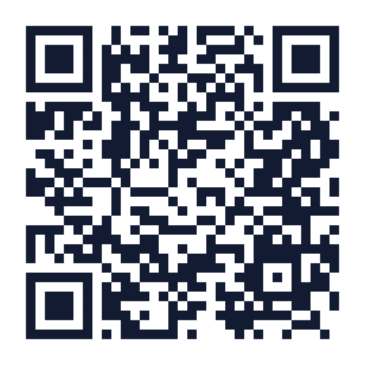
Eric Molho
Principal and Founder
Bon Partners

Slide 2
One Way to Think About AI
Knows some stuff . . . but not everything
Work products are good. . . but not ready for prime time
Is eager to help . . . but makes mistakes
Can be assigned basic/repetitive tasks . . . but the work needs to be checked
The eager intern
Notes:
Eric

Slide 3
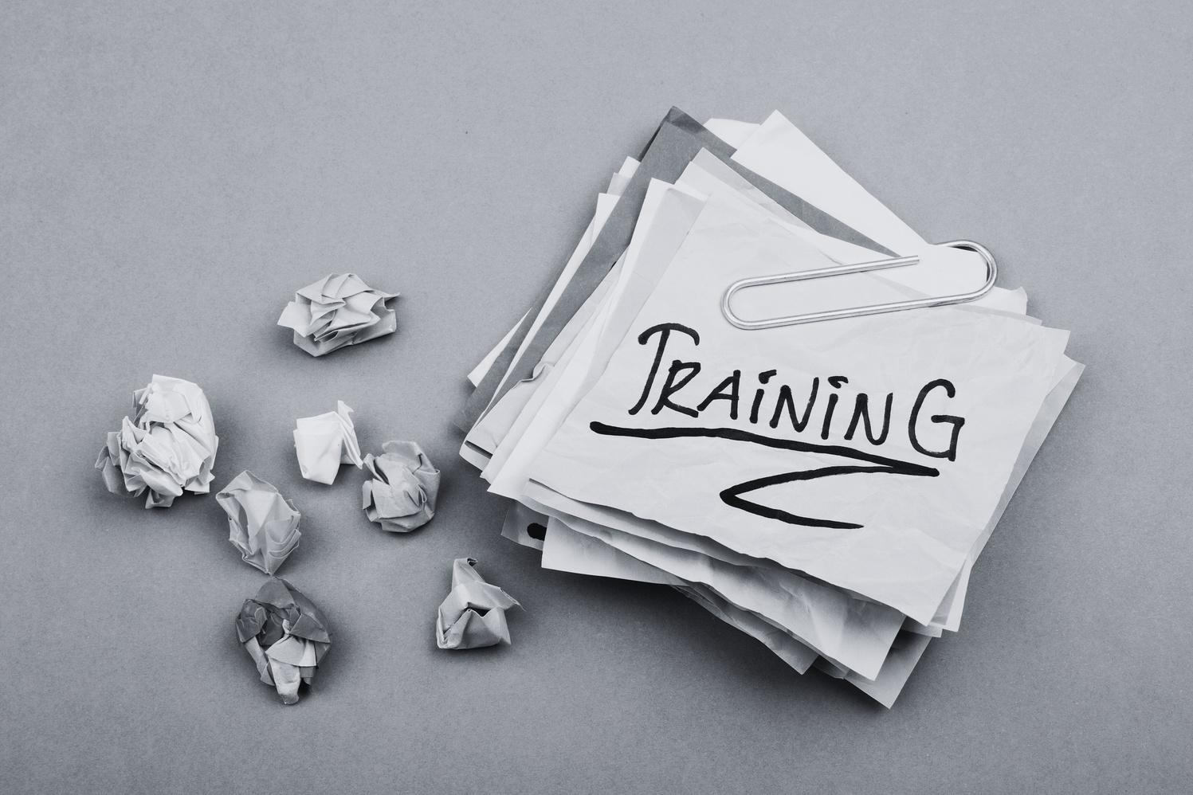
Marketing
Training Tool
AI use cases
Process Docs
Social Media Assistant
Content Drafter
Fundraising
Devil’s Advocate
Notes:
Lori and Eric together

Slide 4
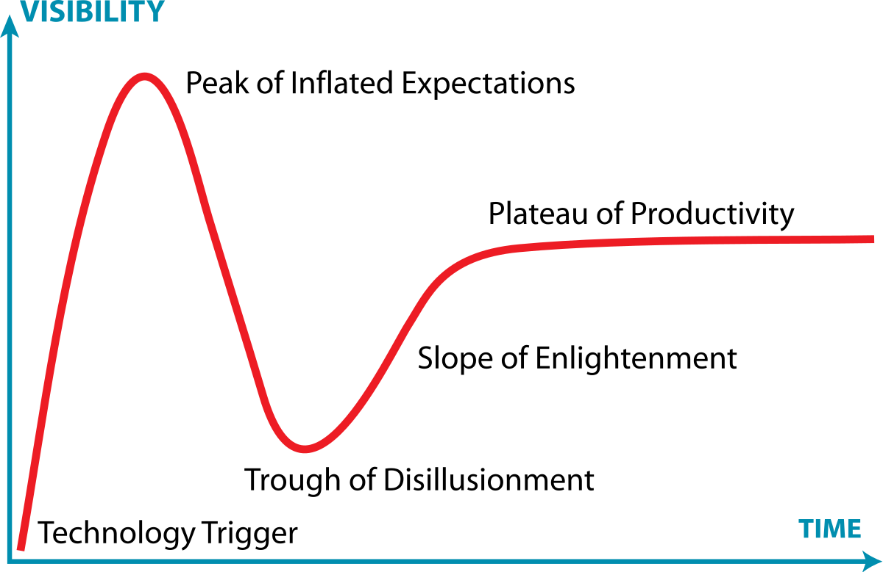
Generative Artificial Intelligence (AI)
Generative: creates new things
Predictive: not programmed
November 30, 2022: ChatGPT Released to the public
Notes:
Eric

Slide 5
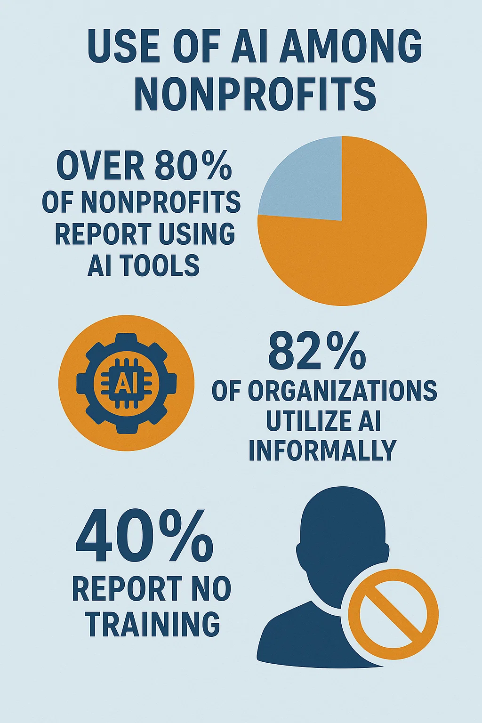
What’s Going On?
📊 AI Adoption in Nonprofits
Widespread Usage: Over 80% of nonprofits report using AI tools in some capacity, primarily for tasks like content creation, grant writing, and internal productivity enhancements. Non Profit News | Nonprofit Quarterly
Informal Implementation: A substantial 82% of organizations utilize AI informally, often without structured integration into team processes. Bloomerang
Limited Staff Training: Approximately 40% of nonprofits indicate that no one in their organization has received education or training in AI. Nonprofit Tech for Good

Slide 6
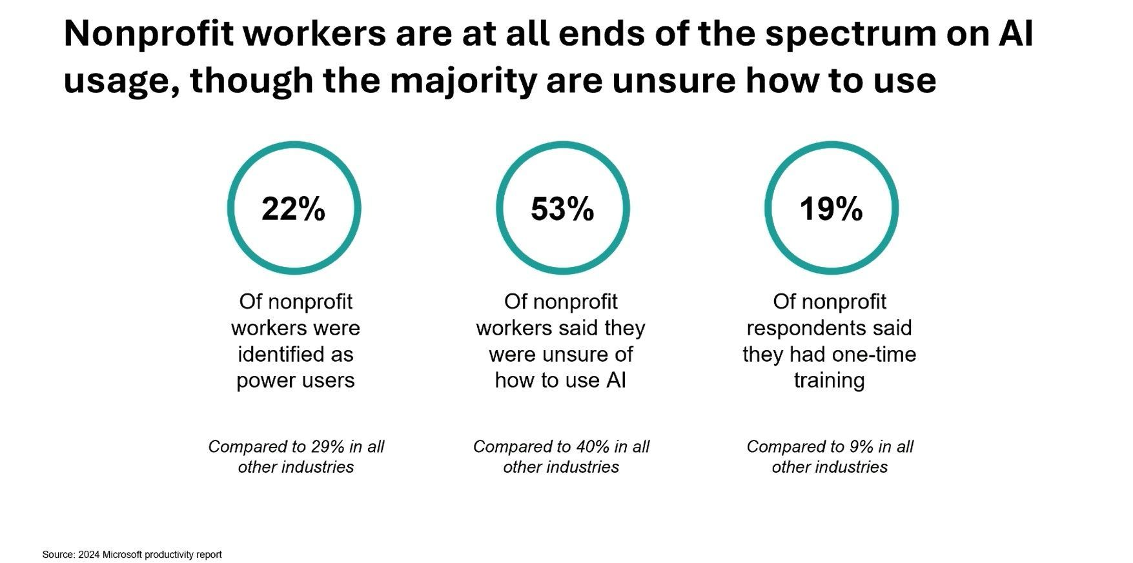

Slide 7
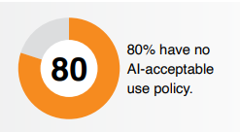
AND . . .
⚠️ We Lack AI Policies
Policy Deficiency: A significant 80% of nonprofits do not have an AI policy in place, leaving them vulnerable to issues related to data privacy, security, and ethical considerations. TechSoup 2025 Survey
Foundations Lagging: Among philanthropic foundations, only 30% have established an AI policy, and a mere 4% report enterprise-wide AI adoption. Technology Association of Grantmakers
Unpreparedness: A staggering 92% of nonprofits feel unprepared for AI integration, citing inadequate infrastructure and a lack of clear policies. Non Profit News | Nonprofit Quarterly+1Bloomerang+1

Slide 8
So what?
Your client, organizational and donor data may be used improperly.
Your employees aren’t sure what is permitted/isn’t permitted.

Slide 9
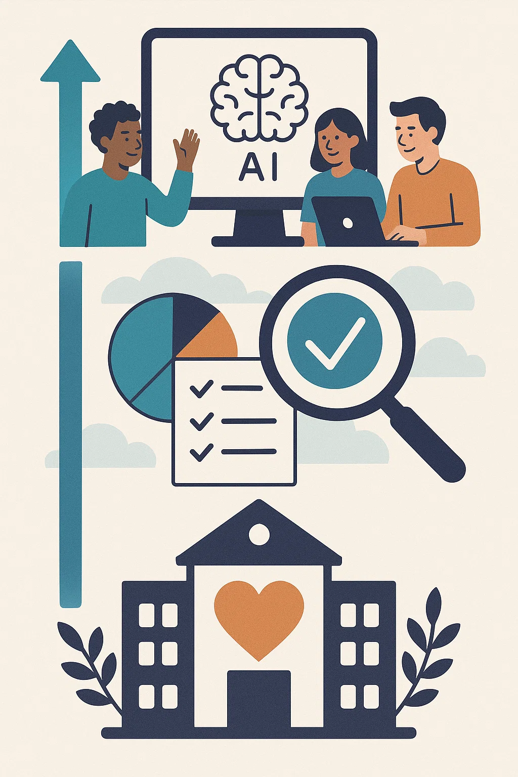
Your mission
Create a culture of AI usage in your organization that:
Helps everyone become more efficient and effective
Creates a culture of transparency and accuracy around AI usage
Honors your organization’s values, mission and responsibilities

Slide 10
Areas of Exploration
Appropriate Use | What system(s) are allowed? Who has access?
Identifying/Mitigating bias | How to we review and evaluate results for bias?
Ensure Accuracy | How do we verify accuracy?
Data Protection and Privacy | How do we align with our existing data privacy policies? What processes are in place?
Transparency/Accountability | When do we disclose use of AI? How to record its use in our work?
Training | What professional development is required?
Misuse (intentional/unintentional) | What will we do to prevent misuse? What will happen if we detect misuse?
Reporting Misuse | How is misuse or other policy violation reported?
External Collaborations | What is the process for approving partnerships? Sharing data?
AI Meeting Notetakers | What is our process to assure permission is granted?
Copyright | How do we assure our use of AI does not violate intellectual property protections?

Slide 11
AND . . .
⚠️ We Lack AI Policies
Policy Deficiency: A significant 80% of nonprofits do not have an AI policy in place, leaving them vulnerable to issues related to data privacy, security, and ethical considerations. TechSoup 2025 Survey
Foundations Lagging: Among philanthropic foundations, only 30% have established an AI policy, and a mere 4% report enterprise-wide AI adoption. Technology Association of Grantmakers
Unpreparedness: A staggering 92% of nonprofits feel unprepared for AI integration, citing inadequate infrastructure and a lack of clear policies. Non Profit News | Nonprofit Quarterly+1Bloomerang+1

Slide 12
How do we do it?
A Framework
Find/use
Start
Start the conversation
Develop
Develop a policy
Launch
Launch training and support

Slide 13
What are the biggest risks for your organization?
start there
Client data
Donor data
Financial data
Copyright
Brand
Accuracy
Bias
Sustainability
Vendors/contractors

Slide 14
Good Enough
Is
Good Enough!
Other Useful Resources:
Your team
AI itself
Your board
Your IT folks
Your colleagues
Consultants

Slide 15
Appropriate Use
Description: Defines clearly which AI tools staff may use and who can access them.
How a Reasonable Policy Might Address This:
Define approved AI tool(s) (e.g., ChatGPT, Grammarly, Canva AI), clearly documented in the organization’s technology policy.
Explore subscription models for data privacy and collaboration
Assign different AI tool permissions based on roles (e.g., development staff can use fundraising analytics AI, marketing staff can use content generation tools).
Regularly update the list based on data security and privacy audits.

Slide 16
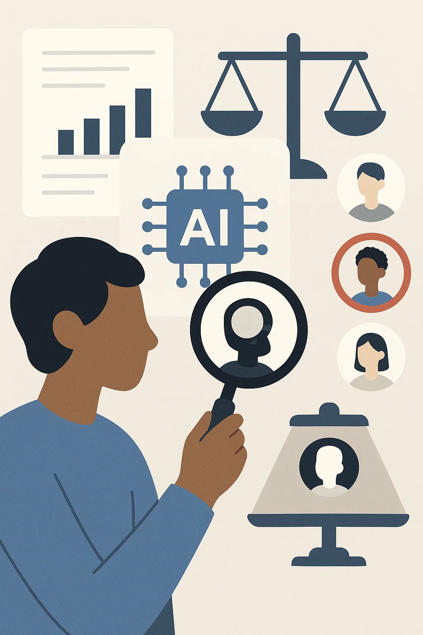
Identifying & Mitigating Bias
Description: Establishes methods to actively review AI outputs for potential bias or unintended discrimination.
How a Reasonable Policy Might Address This:
Require human oversight for AI-generated donor segmentation to prevent demographic bias (racial, socioeconomic, geographic).
Conduct quarterly “AI bias audits” to review AI-assisted communication materials (newsletters, appeal letters) for unintended stereotyping or exclusion.
Provide staff training on recognizing AI-generated biases.
Require or review two-person proofreading and other quality control processes

Slide 17
Ensuring Accuracy
Description: Outlines procedures to verify that AI-generated content or data is accurate and trustworthy.
How a Reasonable Policy Might Address This:
Require verification of all AI-generated statistics or factual statements before public dissemination (e.g., fact-check program descriptions in grant proposals).
Implement a two-step review process for AI-produced donor or client reports: one review for accuracy, one for ethical alignment.
Clearly document and archive reviews for accountability.

Slide 18
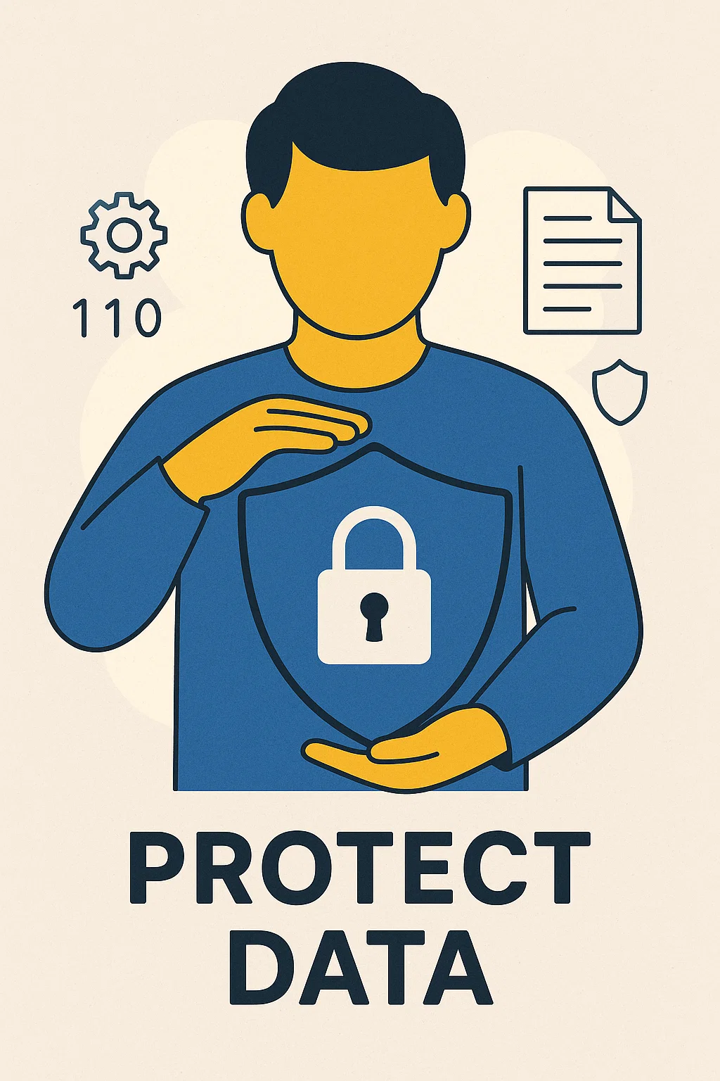
Data Protection & Privacy
Description: Ensures AI use aligns fully with the nonprofit’s existing data privacy policies.
How a Reasonable Policy Might Address This:
Prohibit or limit staff from uploading sensitive client or donor information (personally identifiable or health-related data) into public AI tools.
Create explicit guidelines for anonymizing data before AI processing (e.g., removing names, locations, specific details that identify individuals); require review/approval of manager before AI processing.
Train staff annually on secure data handling practices related to AI tools.

Slide 19
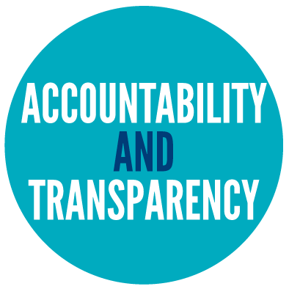
Transparency and Accountability
Description: Clarifies when to disclose AI usage and how to maintain accountability.
How a Reasonable Policy Might Address This:
Include a requirement for staff to note explicitly when AI significantly contributed to written materials or data analyses presented to boards or funders.
Maintain an internal log of AI tool use for transparency and auditing purposes.
Establish clear internal reporting lines for staff questions or concerns about AI transparency.

Slide 20
Training & Professional Development
Description: Defines the professional development required to responsibly use AI within the nonprofit.
How a Reasonable Policy Might Address This:
Require staff using AI to complete an annual internal training session covering data ethics, AI biases, and privacy risks.
Provide specialized training modules depending on the AI tools staff will use (fundraising tools, marketing automation, program evaluation tools).
Evaluate staff competence periodically through brief assessments or scenario-based exercises.

Slide 21
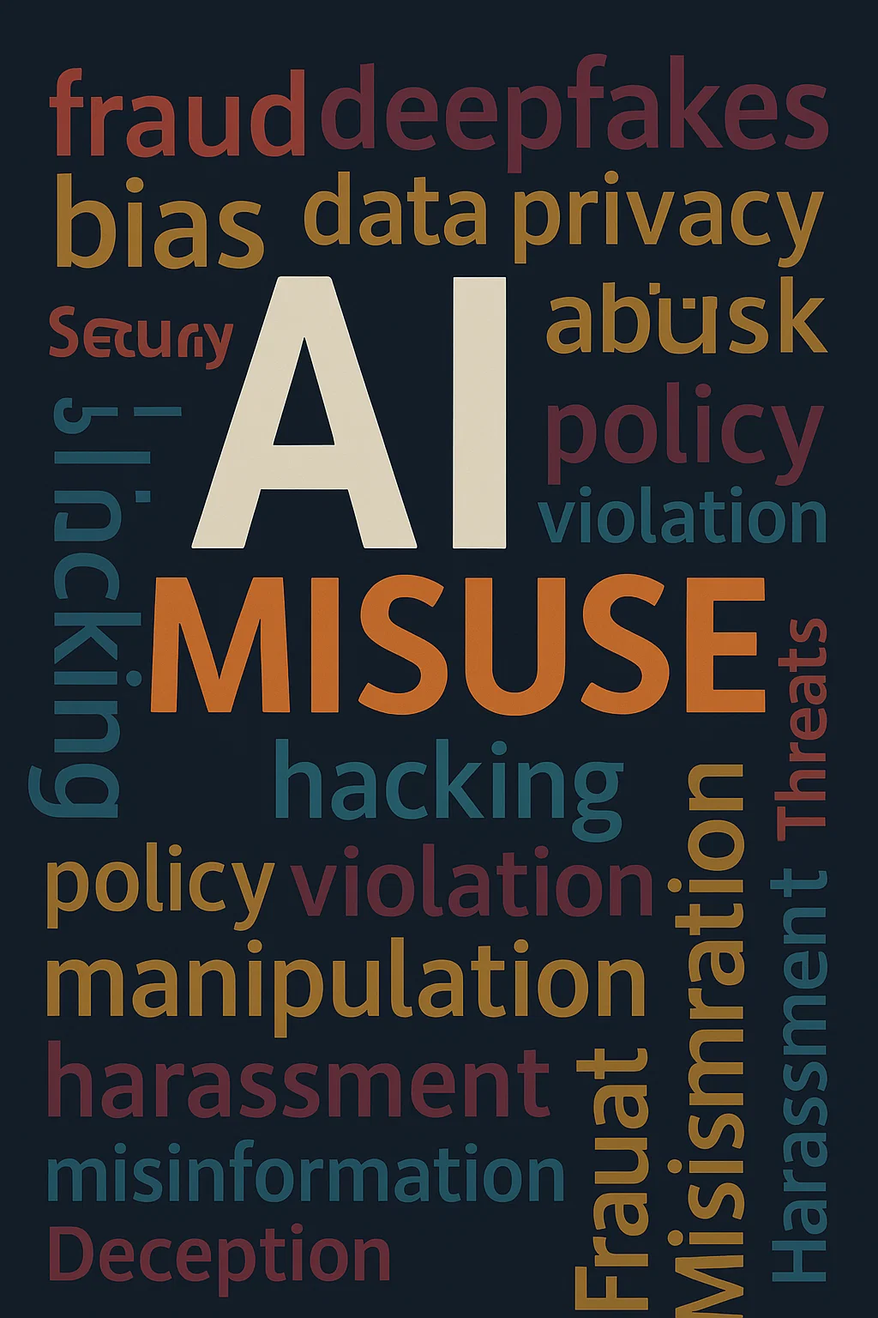
Misuse
Description: Defines misuse clearly and outlines preventive measures and disciplinary actions.
How a Reasonable Policy Might Address This:
Clearly define misuse, such as inappropriate use of sensitive data, plagiarism, or generating misleading content.
Implement clear warnings within tools themselves to prompt cautious data handling (e.g., pop-up reminders when uploading data).
Update existing policies to include AI infractions. Outline graduated responses to misuse: first accidental misuse triggers training, intentional misuse triggers disciplinary review.

Slide 22
Reporting Misuse
Description: Clarifies reporting channels and procedures for suspected misuse of AI tools.
How a Reasonable Policy Might Address This:
Update and leverage existing whistleblower policies for confidential reporting managed by HR or IT.
Train staff annually on how to recognize and report misuse.
Foster a culture emphasizing responsible AI use through ongoing communication and feedback mechanisms.

Slide 23
External Collaborations
Description: Provides guidelines for approving partnerships or vendors who utilize AI.
How a Reasonable Policy Might Address This:
Require external vendors using AI (e.g., fundraising consultants, CRM providers) to submit their AI usage policy or data security standards for review.
Include data-sharing protocols explicitly in contracts with vendors or partners (e.g., requiring vendor compliance with your privacy standards).
Regularly audit these collaborations to ensure ongoing compliance and alignment with organizational values.

Slide 24
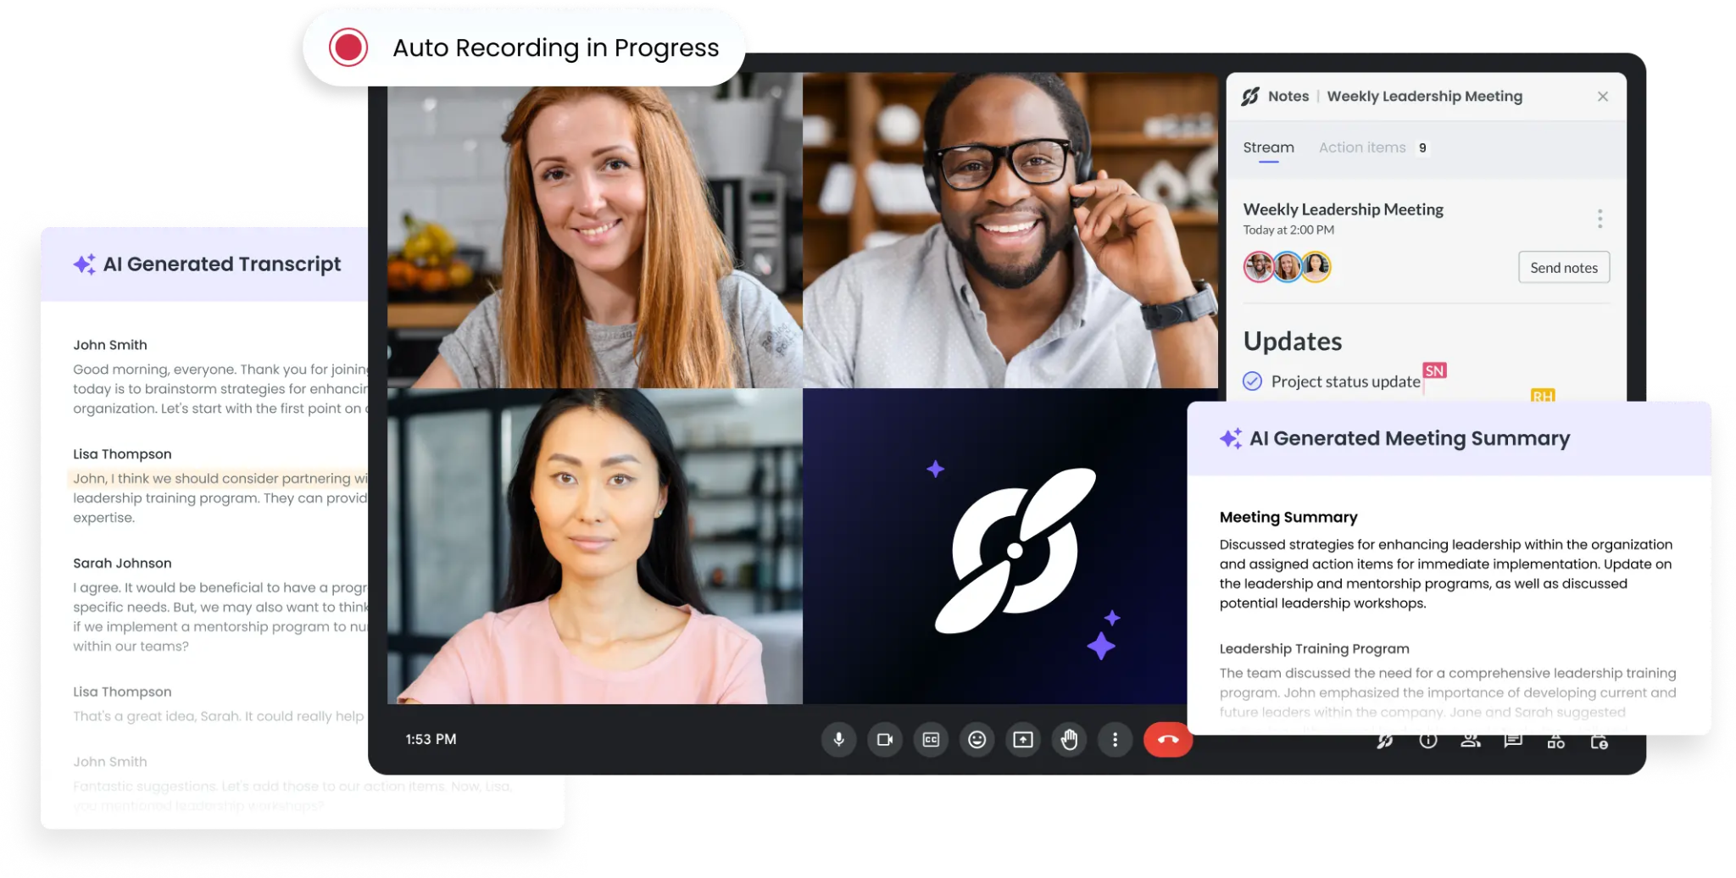
Meeting Notetakers
Description: Outlines consent processes required for AI-generated meeting notes or transcriptions.
How a Reasonable Policy Might Address This:
Require explicit participant consent (written or verbal) before using AI tools (e.g., Otter.ai, Zoom transcription) to record meetings.
Clearly label meetings using AI transcription in calendar invites, so participants can opt-out if necessary.
Develop an internal guideline outlining secure storage, access, and deletion policies for AI-generated meeting transcripts.

Slide 25
Copyright
Description: Ensures compliance with intellectual property laws and best practices in AI-generated content.
How a Reasonable Policy Might Address This:
Require checking licenses and terms of service when using AI-generated images, graphics, or text (e.g., DALL·E, Adobe Firefly).
Maintain subscriptions or licenses to AI tools specifically designed to deliver copyright-safe outputs.
Provide training on basic copyright law, fair use, and public domain concepts for staff who generate or approve AI-generated materials.

Slide 26
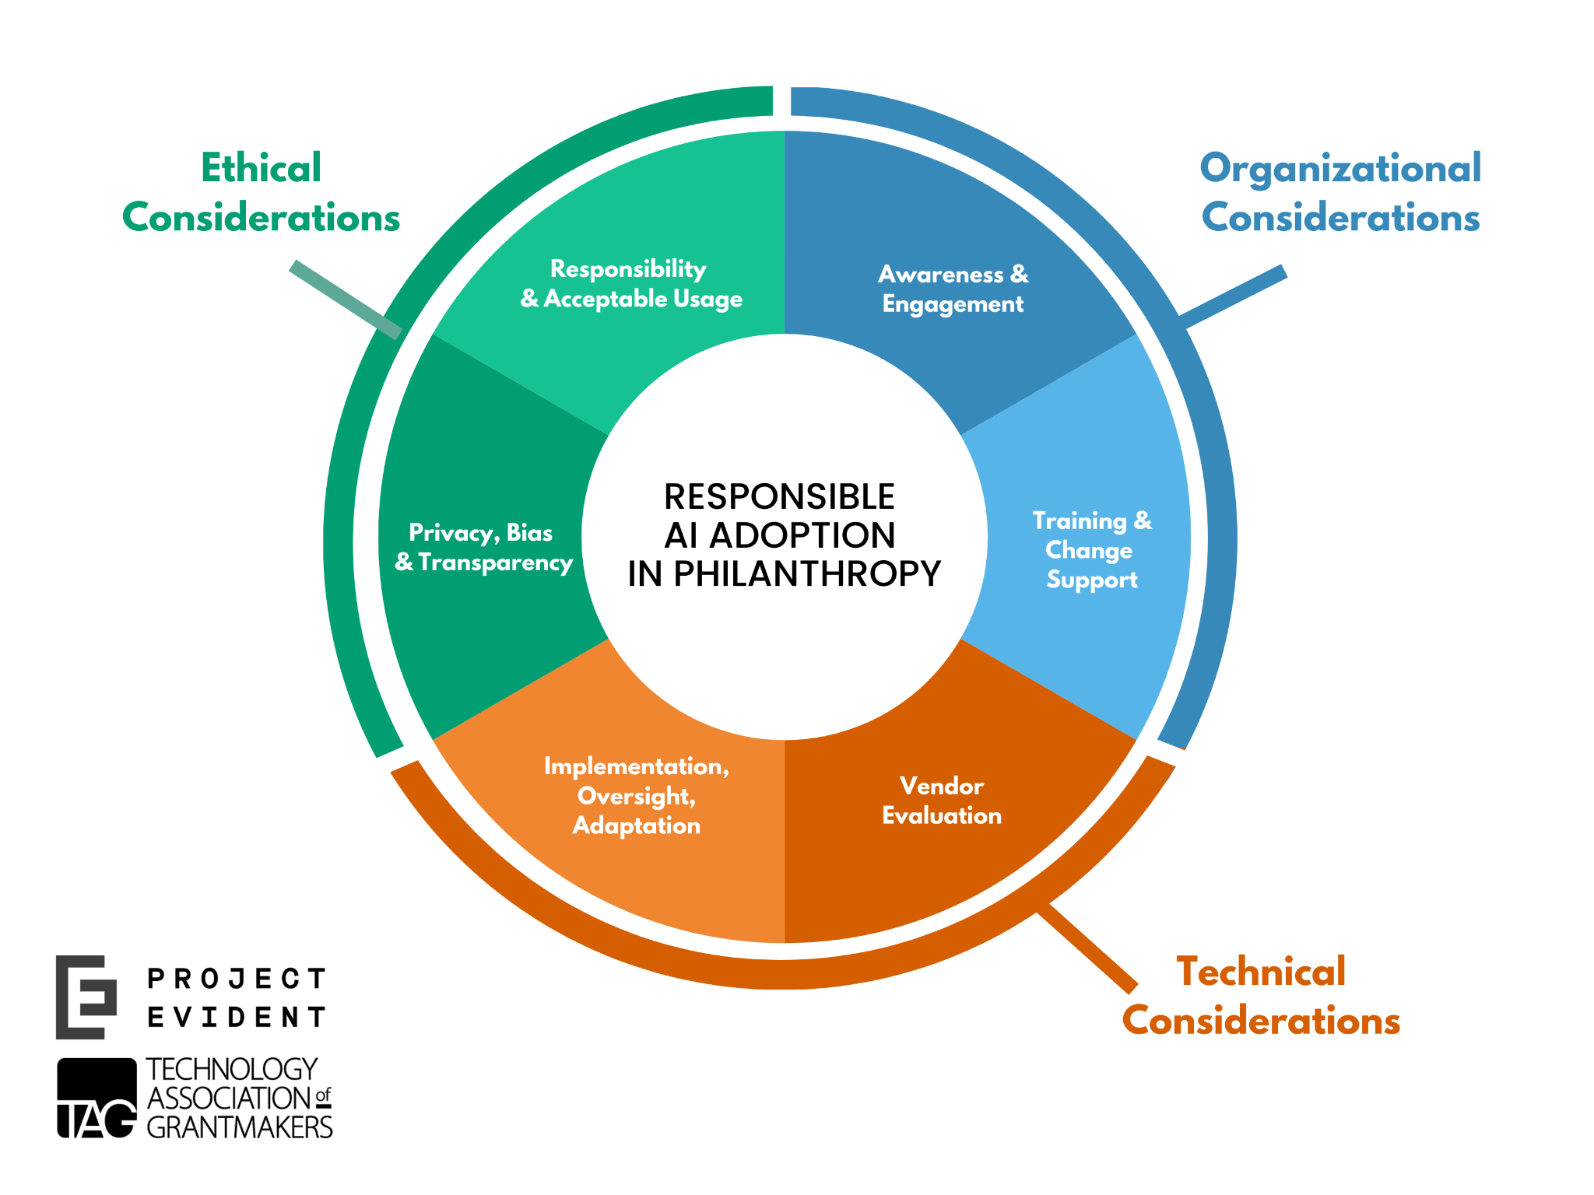
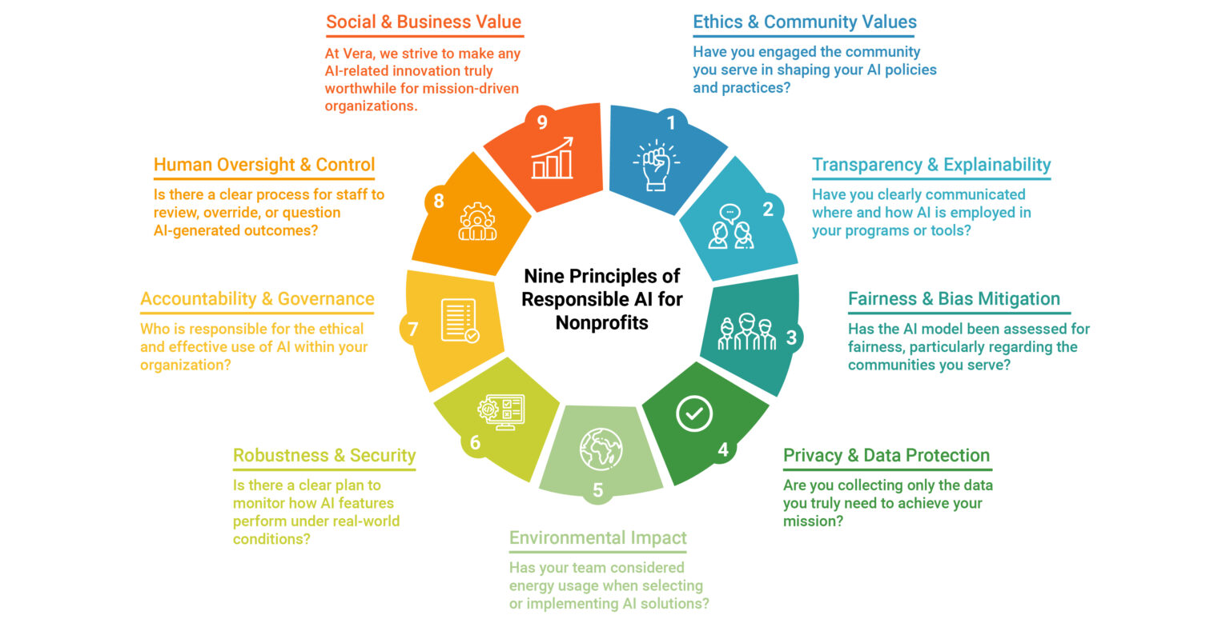
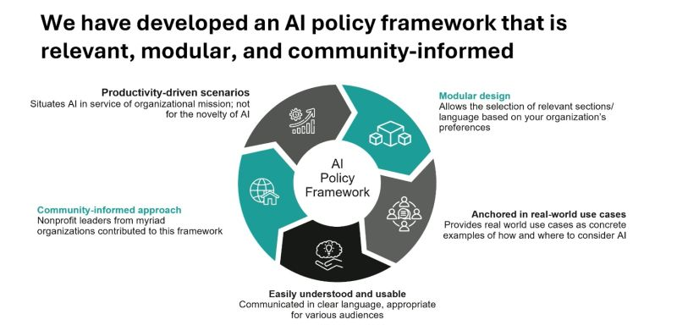
Frameworks and Tools

Slide 27
