Slide 1



HOLDING SPACE
Without Losing Yourself
Presented By:
Jill McDonald & Christy Miller

Slide 2


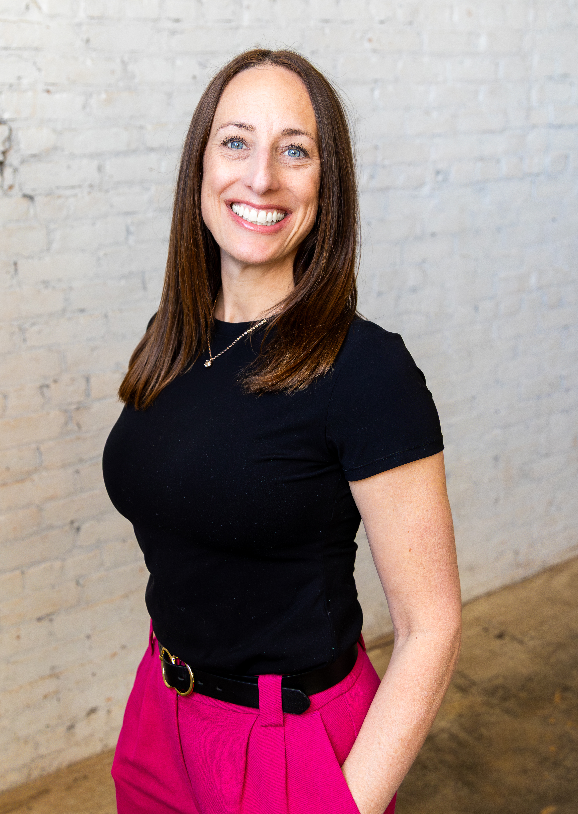
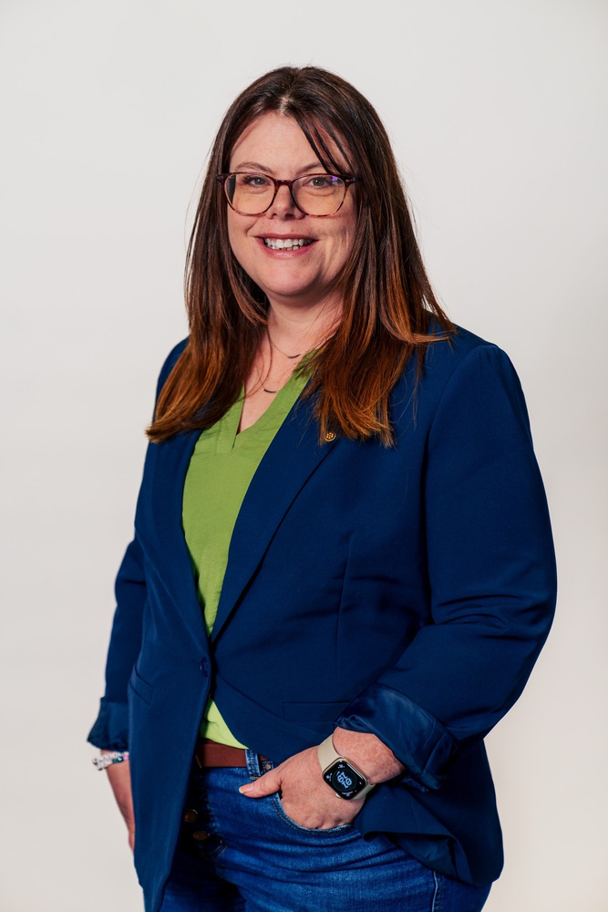
Welcome
  Introduction
  Pulse Check
  Group Agreements

Slide 3



What Does Burnout Look Like?
  Nonprofit culture impacts
  Observations from an outsider
  Activity

Slide 4



Self Assessment
  Physical
  Emotional
  Relational
  Professional
  Spiritual/Meaning
  Cognitive

Slide 5



FLY Framework
FIRST LEAD YOURSELF
Healed People Heal People
Strategies for Combating Depletion
Wellness Industry Observation

Slide 6

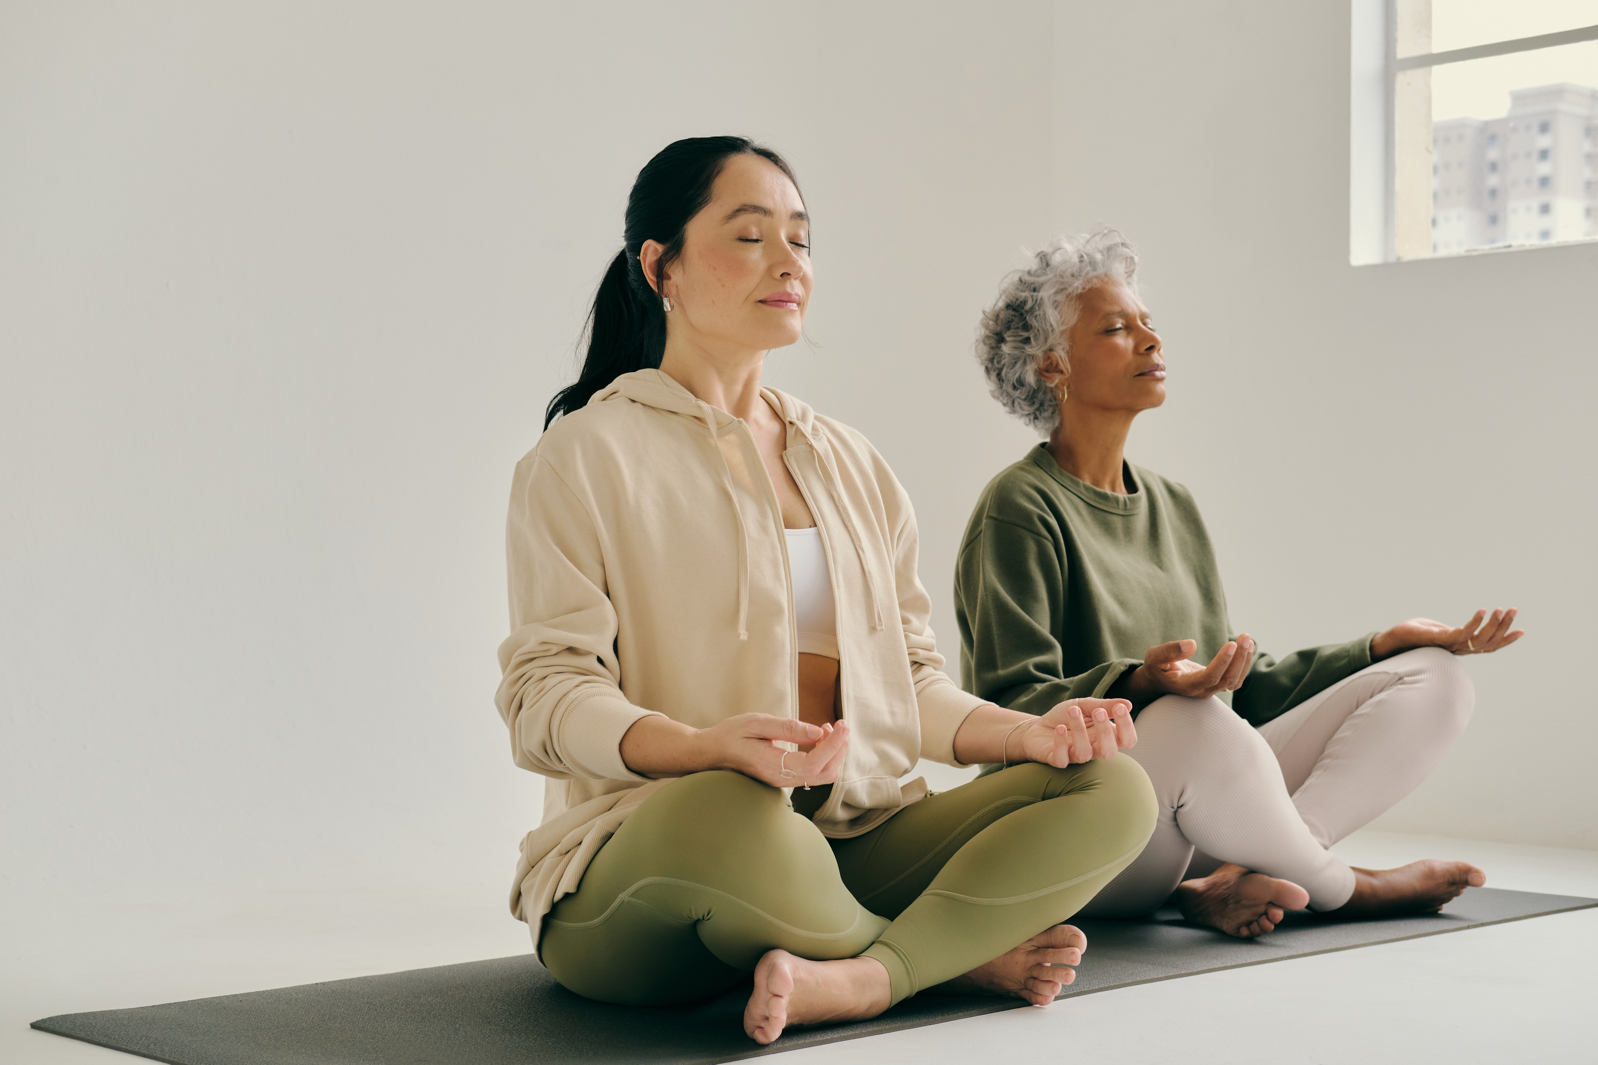
The Outside View

Slide 7



What Can I Do?

Slide 8

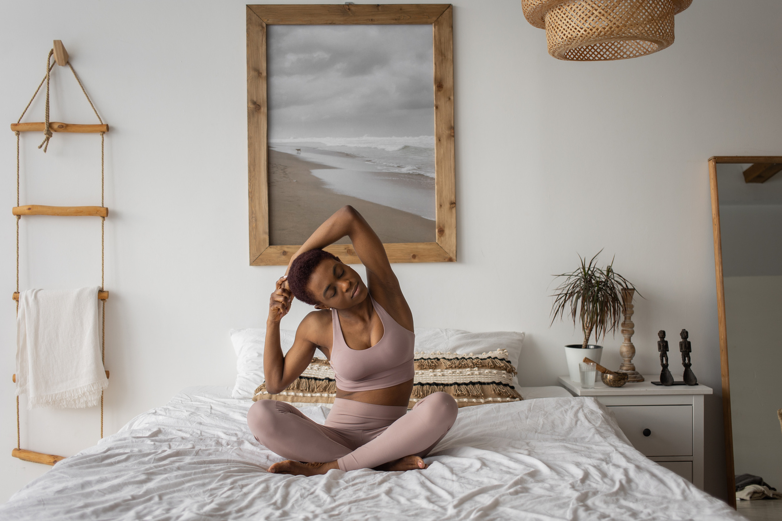

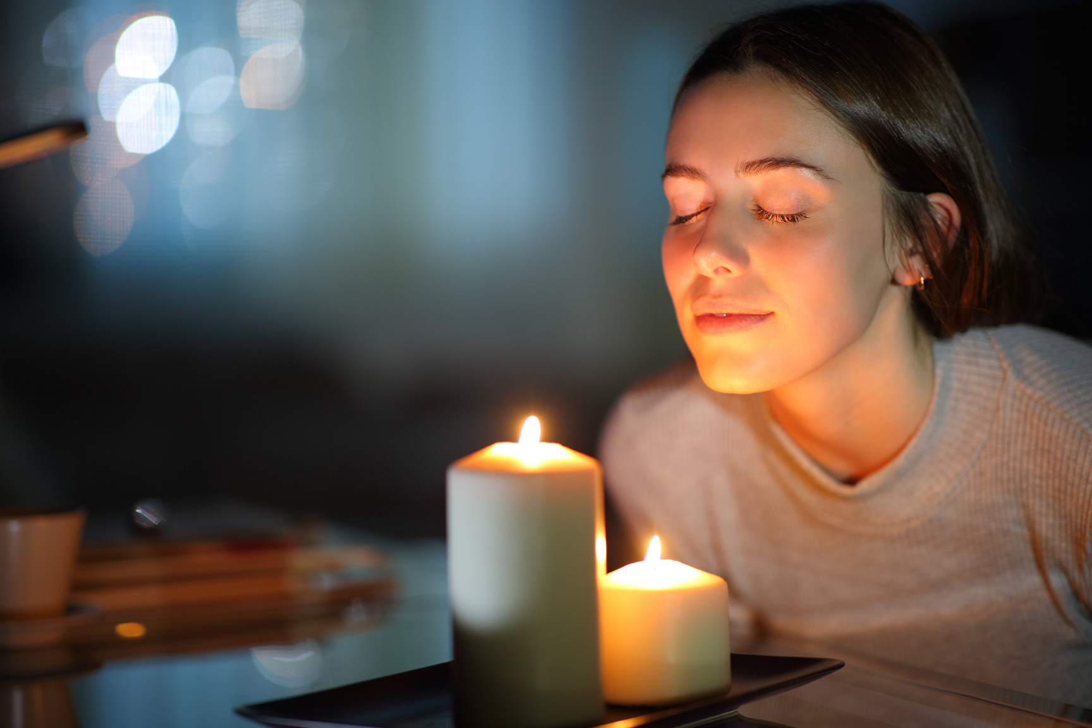
Sustainability Plan
Morning Routine
During the Day
Before Bed

Slide 9


Commitment

Slide 10



THANK YOU!
Presented By: Jill McDonald &
Christy Miller
Contact Info
jill@dvccminot.org
christy@svunitedway.com

