Slide 1

June 4, 2026
ND State Fair Center- 4-H Hall

Slide 2

Emerging Leader Award
Significant impact in strengthening the North Dakota nonprofit sector in a short amount of time within the field

Slide 3
Emerging Leader Award previous winners
2022 – Maura Ferguson
2021 – Becca Baumbach
2020 – Becca Cruger
2019 – Billi Jo Zielinski
2018 – Dayna Del Val
2017 – Stacy Schaffer
2016 – Jessica Thomasson
2014 – Ty Hegland
2013 – Luke Klefstad
2023 – Ted Uecker
2025 - Jakelle Hoffmann
2024 - Matthew Ternus

Slide 4
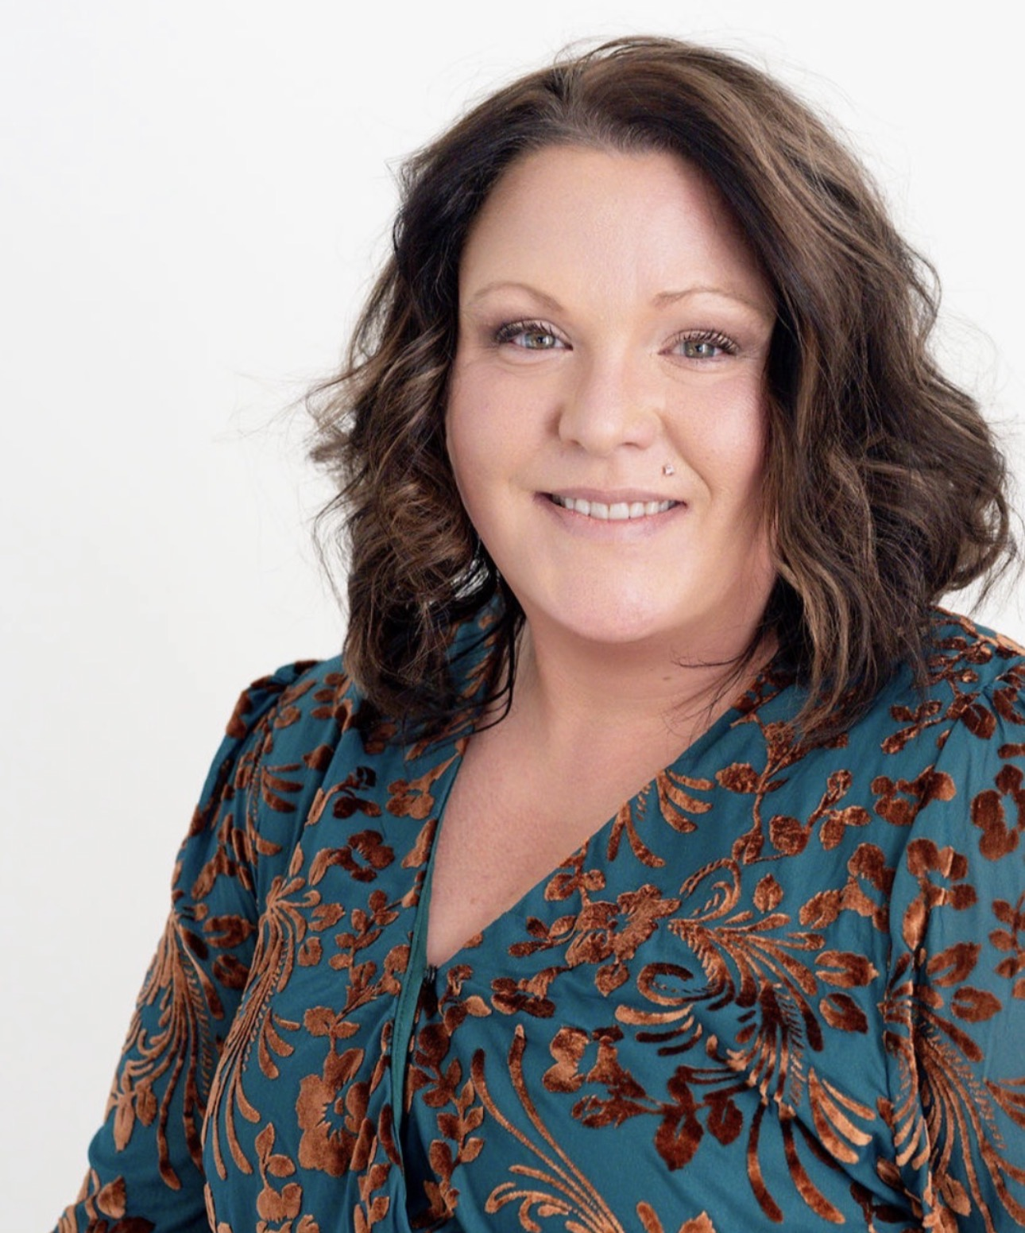
2026
Emerging Leader Award winner
Shani Reisnour

Slide 5
Partnership Building Award
Demonstrated community leadership and built partnerships within the North Dakota nonprofit sector

Slide 6
Partnership Building Award
Previous winners
2022 – Jeremiah Program
2021 – Community Violence Intervention Center
2020 – Spectra Health
2019 – FirstLink's Suicide Follow Up Call Team
2018 – Fargo-Moorhead Coalition for Homeless Persons
2017 – Bismarck Parks and Recreation District
2016 – Nonprofit Business Alliance
2015 – FUSE North Dakota
2014 – Lutheran Social Services of North Dakota
2013 – Marathon Oil Company
2023 – Community Foundation of Grand Forks, East Grand Forks & Region
2024 - Bismarck Opioid Overdose Partnership
2025 - Bismarck Dream Center

Slide 7
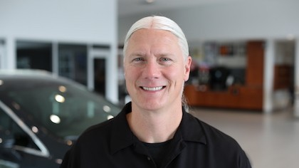
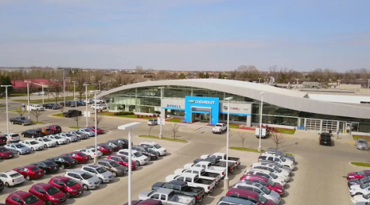
2026
Partnership Building Award winner
Rydell Cars

Slide 8
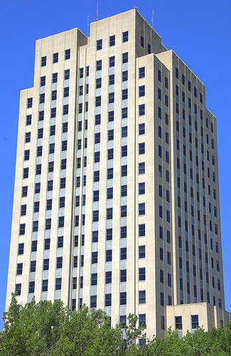
Legislative champion award
Advocacy within the state legislature has made a lasting impact for North Dakota nonprofits and strengthened the state nonprofit sector.

Slide 9
Previous legislative champions
Rep. Mark Sanford
Sen. Erin Oban
Rep. Tracy Boe
Rep. Ruth Buffalo
Rep. Gretchen Dobervich
Sen. Joan Heckaman
Sen. Kathy Hogan
Sen. Judy Lee
Rep. Shannon Roers Jone
Sen. Kathy Hogan
Rep. Mary Schneider
Rep. Emily O'Brien
Sen. Judy Lee

Slide 10
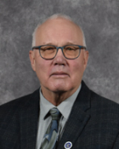
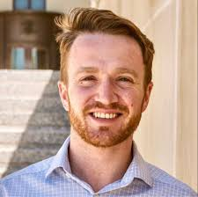
2026
Legislative Champions
Sen. Sean Cleary & Rep. Jon O. Nelson

Slide 11
Walt Odegaard Leadership Award
Significant impact in strengthening the North Dakota nonprofit sector through long-term commitment to leadership, volunteerism and/or philanthropy

Slide 12
Walt Odegaard Leadership Award Previous Winners
2022 – Jim Vetter
2021 – Heather Helgeson
2020 – Rose Stoller
2019 – Franklin G. Larson
2018 – Sharon E. Buhr
2017 – Hal and Kathleen Gershman
2016 – Kevin J. Dvorak and Sandra Marshall
2015 – Larry Robinson
2014 – Diane Zainhofsky
2013 – William Pearce
2025 - Christy Dauer
2023 – Kurt Snyder
2024 - Kim Konikow

Slide 13
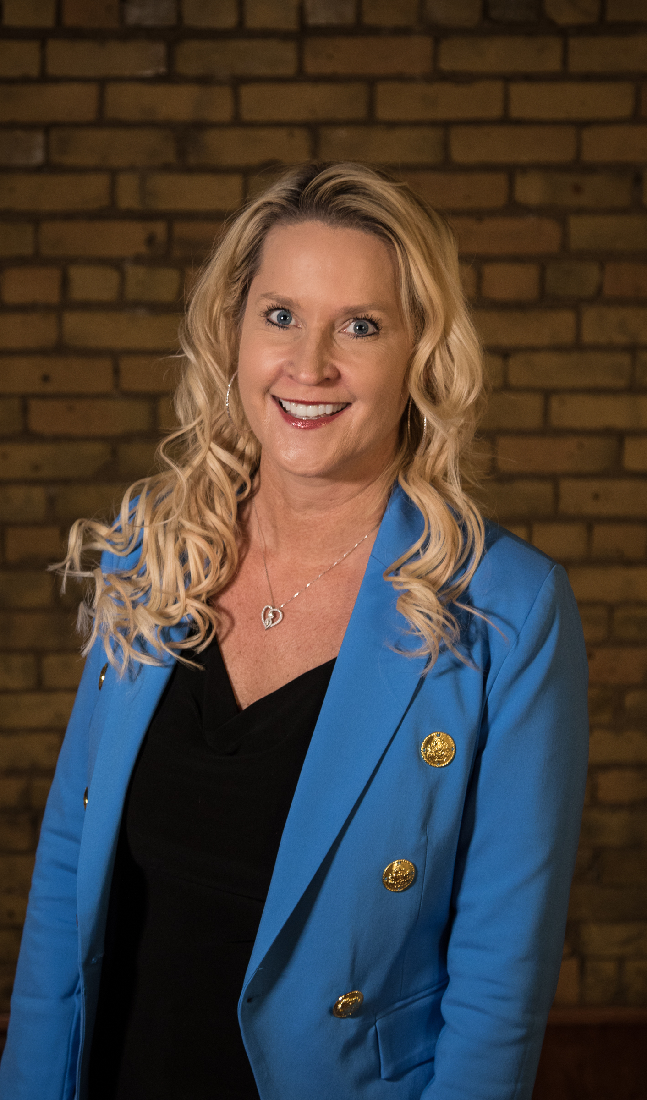
2026
Walt Odegaard Leadership Award Winner
Coiya Tompkins Inman

Slide 14
Congratulations to all winners!

