Slide 1

Welcome
Annual Member Meeting
June 4, 2026
Educate. Advocate. Connect.

Slide 2
Agenda
Call to Order
Approval of June 5, 2025 Minutes*
Recognition of Board Service
Returning Board Members
New Board Members Nominations
Year in Review
Looking Forward
Adjourn
Educate. Advocate. Connect.

Slide 3
NDANO
Annual Meeting Minutes
June 5, 2025
Annual Meeting Minutes
June 5, 2025 Ballroom, Holiday Inn, Fargo N.D.
Call to Order: Myrna Hanson, Board Chair and Executive Director, Community of Care.
Time: Meeting called to order at 8:05 a.m. CDT.
Chair welcomed attendees, encouraged continued enjoyment of breakfast, and opened the Annual Meeting.
Attendance & Quorum
A quorum of members was present.
Board members in attendance were asked to stand and were acknowledged for their statewide representation and sector diversity.
Approval of 2024 Annual Meeting Minutes
Motion: Lindsey Ulrickson moved to approve the 2024 minutes.
Second: Anne Stoll
Discussion: None.
Vote: Motion carried unanimously.

Slide 4
NDANO
Annual Meeting Minutes
June 5, 2025
Annual Meeting Minutes cont.
Board Governance Committee Report
Election of New Board Directors (3-year terms, 1st term)
Nominations from the floor: None (called three times)
Motion: Slate approved by unanimous voice vote.
Re-election of Incumbent Directors (3-year terms, 2nd term)
Motion: To re-elect the above directors for an additional term.
Vote: Carried unanimously.
Nominee | Organization | Location
Megan Indvick | F5 Project (now with Americans for Prosperity) | Minot
Sargianna Wutzke | Arts for All | Bismarck
Melissa Smith | Bakken Oil Rush Ministries (now with CrossPoint Church) | Watford City
Sue Omdalen | Essentia Health | Fargo
Melanie Gabe | Alzheimer’s Association (now with Shift Happens Consulting) | Bismarck

Slide 5
NDANO
Annual Meeting Minutes
June 5, 2025
Annual Meeting Minutes cont.
Election of 2025–26 Officers
Elected by the Board at its meeting on June 2, 2026; announced to the membership.
Executive Director’s 2024 Report
Financial Snapshot
  FY 2024 operated at a modest deficit; positive cash reserves increased ~20 percent following CD maturities and reinvestment.
Education & Training
  2024 NDANO Conference (Bismarck) successfully delivered.
  Partnership webinars with Bloomerang, DonorDock, Grant Station, National Council of Nonprofits, and peer state associations.
  Two monthly e-newsletters: Learning Outlook (training focus) and the general NDANO newsletter.
Office | Officer | Organization
President | Patrick Kirby | Do Good Better Consulting
Vice-President | Lindsey Ulrickson | Bush Foundation
Treasurer | Anne Stoll | Eide Bailly
Secretary | Susan Omdalen | Essentia Health

Slide 6
NDANO
Annual Meeting Minutes
June 5, 2025
Annual Meeting Minutes cont.
Advocacy
  Continued sales of the NDANO Nonprofit Advocacy Toolkit; delivered “Advocacy 101” sessions.
Research & Publications
  New North Dakota Nonprofit Impact Report released Feb 2025; posters and hard copies available at registration desk.
Membership & Services
  150 nonprofit member organizations and 30 business partners served in 2024.
  Job-posting support and cost-saving benefits highlighted.
Staff Acknowledgments
  Recognized the NDANO team for on-site assistance.
Other Business
No additional business was brought forward from the floor.
Adjournment Meeting adjourned at 8:35 a.m. CDT.
Members were encouraged to review the new sector report, network over breakfast, and return for the keynote session at 8:45 a.m.

Slide 7
Mission
Educate, advocate and connect to strengthen nonprofits.
Educate. Advocate. Connect.

Slide 8
2025
Board of Directors
Patrick Kirby, President, Do Good Better Consulting, Fargo
Lyndsay Ulrickson, Vice President, Bush Foundation, Statewide
Sue Omdalen, Secretary, Essentia Health Foundation, Fargo
Anne Stoll, Treasurer, Eide Bailly, Fargo
Becca Baumbach, Community Foundation of Grand Forks, East Grand Forks & Region
Casondra Duckworth, Jeremiah Program, Fargo
Michelle Erickson, Abused Adult Resource Center, Bismarck
Melanie Gaebe, Shift Happens Consulting, Statewide
Myrna Hanson, Community of Care, Casselton
Megan Indvik, Americans For Prosperity, Minot
Tracy LeDuc, Community Violence Intervention Center, Grand Forks
Gayla Sherman, Missouri Slope Foundation, Bismarck
Stacy Schaffer, 31:8 Project, Bismarck
Melanie Smith, Crosspoint Church, Watford City
Sargianna Wutzke, Arts for All, Bismarck
Murray Sagsveen/ David Tibbals, JD, Attorney
Educate. Advocate. Connect.

Slide 9
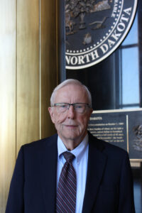
Recognition of Service
Murray Sagsveen

Slide 10
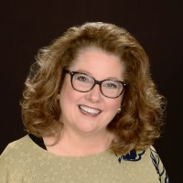
Recognition of Service
Gayla Sherman

Slide 11
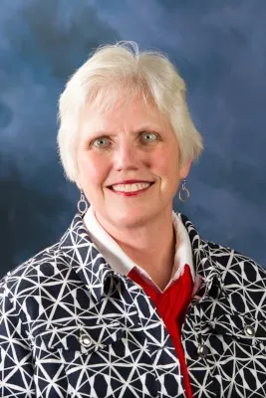
Recognition of Service
Myrna Hanson

Slide 12
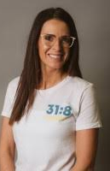
Recognition of Service
Stacy Schaffer

Slide 13
Board Members Seeking Another Term
Michelle Erickson, Abused Adult Resource Center
Casondra Duckworth, Jeremiah Program
Lyndsay Ulrickson, Bush Foundation
Educate. Advocate. Connect.

Slide 14
Returning Board Members
Patrick Kirby, President, Do Good Better Consulting, Fargo
Lyndsay Ulrickson, Vice President, Bush Foundation, Statewide
Sue Omdalen, Secretary, Essentia Health Foundation, Fargo
Anne Stoll, Treasurer, Eide Bailly, Fargo
Becca Baumbach, Community Foundation of Grand Forks, East Grand Forks & Region
Casondra Duckworth, Jeremiah Program, Fargo
Michelle Erickson, Abused Adult Resource Center, Bismarck
Melanie Gaebe, Shift Happens Consulting, Statewide
Megan Indvik, Americans For Prosperity, Minot
Tracy LeDuc, Community Violence Intervention Center, Grand Forks
Melanie Smith, Crosspoint Church, Watford City
Sargianna Wutzke, Arts for All, Bismarck
David Tibbals, JD, Attorney (non-voting)
Educate. Advocate. Connect.

Slide 15
New Board Member
Nominees
Zoe Wergeland Manstrom, Red Cross (Bismarck/Western half of state)
Lisa Aisenbrey, Dakota Boys & Girls Ranch (Bismarck and Statewide)
Michael Helt, 1st Care Health Center (Park River).
Educate. Advocate. Connect.

Slide 16
Year in Review:
NDANO in 2025
Educate. Advocate. Connect.

Slide 17
2025
Financials
Revenue: $111,624
Expenses: $ 147,220
Positive Cash Reserve: $222,707
Educate. Advocate. Connect.

Slide 18
2025
Nonprofit
Membership
(152)
By Budget
By Sector
Educate. Advocate. Connect.

Slide 19
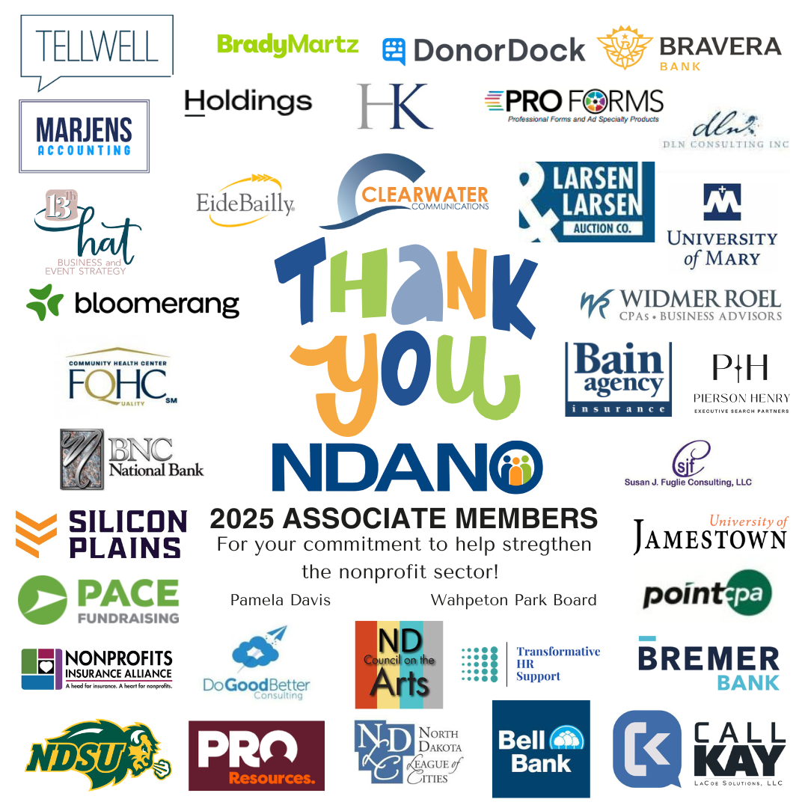

2025
Associate
Membership
(40)
Educate. Advocate. Connect.

Slide 20
Educate
Provide a variety of learning opportunities, sector news and best practice resources:
Held the annual Nonprofit Leadership Conference in Fargo with over 100 attendees.
Shared more than 100 learning opportunities offered by partners, quarterly Firespring learning opportunities; Grantstation programs; MindEdge programs; and much more.
Continued the monthly “Learning Lookout” education programming update.
Provided technical assistance and referrals to members and potential members.
Published the monthly Nonprofit Network newsletter and distributed information via email and social media on timely nonprofit issues.
Educate. Advocate. Connect.

Slide 21
Advocate
A voice for member organizations and the North Dakota nonprofit sector:
Tracked and monitored bills during North Dakota’s 69th Legislative Assembly.
Hosted Nonprofit Day at the Capitol with over 45 nonprofit organizations in attendance.
Represented nonprofits in various events
Sold and distributed the Nonprofit Advocacy toolkit.
Continued to bring members weekly updates during legislative session.
Marketed and distributed the North Dakota Nonprofit Sector Report.
Championed the sector on National Nonprofit Day on Aug. 17.
Educate. Advocate. Connect.

Slide 22
Connect
A network of members throughout North Dakota and across the country:
Engaged over 150 North Dakota nonprofits as member organizations and 40 businesses, government agencies and individuals as associate members.
Attended many nonprofit-related events statewide.
Posted member job openings on the website and shared via the newsletter as a free member benefit.
Offered cost-saving/preferred partner programs for members.
Connected North Dakota nonprofits to national issues through membership in the National Council of Nonprofits, the largest network of charitable nonprofits in the nation that serves to spot trends and share information critical to every nonprofits’ mission advancement.
Educate. Advocate. Connect.

Slide 23
Looking Forward:
NDANO Staff
Thank you, Clearwater Communications,
Hello, Kayla Deitch
Shawn McKenna, Clearwater Communications
Kayla Deitch
Michaela Randall, Clearwater Communications
Educate. Advocate. Connect.

Slide 24
Adjourn
for your NDANO membership & support
Thank you

