Slide 1
CyberSecurity - 2023-Q2
www.eidebailly.com/cybersecurity

Slide 2
Presenter
Kyle Hendrickson Director - Cybersecurity Services

Slide 3
QBot: 30 Minutes to Compromise Data
https://thedfirreport.com/2022/02/07/qbot-likes-to-move-it-move-it/
On average organizations were only able to recover 64% of their data was restored after paying the ransom.
-Veeam “2022 Data Protection Trends Report”
2.09M - The average cost to remediate a ransomware attack in the US.
-Sophos “State of Ransomware 2022”
1 Month – The average time to recover from a ransomware attack
-Sophos “State of Ransomware 2022”
Medical Imaging Files are now an Extortion Technique
https://www.theregister.com/2023/03/15/cancer_lvhn_sues_hospital/
88% of executives from companies that have been previously
Been hit by ransomware said they would pay if attacked again
https://www.kaspersky.com/blog/anti-ransomware-day-report/
-PaloAlto Unit42 “2022 Ransomware Threat Report”

Slide 4
We don’t get to choose if we are a target
www.eidebailly.com/cybersecurity
Notes:
People process and technology solutions

Slide 5
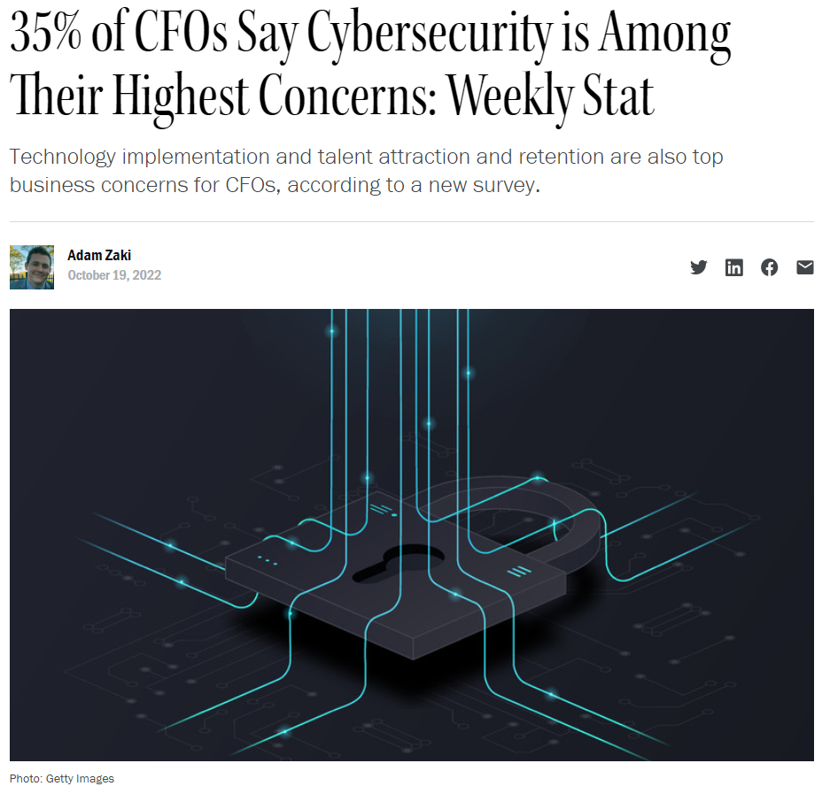
https://www.washingtonpost.com/technology/2022/10/05/uber-obstruction-sullivan-hacking/
https://www.cfo.com/technology/2022/10/cfo-priorities-cybersecurity-retention-hiring-technology-automation/

Slide 6
https://www.washingtonpost.com/technology/2022/10/05/uber-obstruction-sullivan-hacking/

Slide 7
Cyber Risk is Business Risk
www.eidebailly.com/cybersecurity
Notes:
People process and technology solutions

Slide 8
-PaloAlto Unit42 “2022 Ransomware Threat Report”

Slide 9
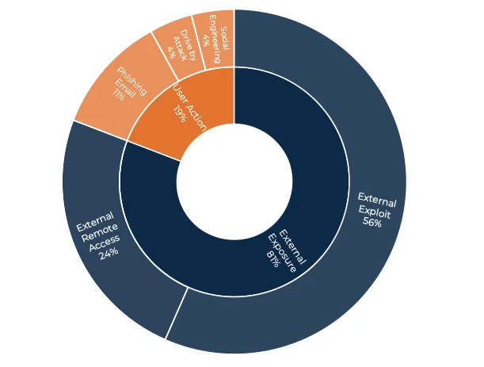
- 2023 Arctic Wolf Networks, Inc
-PaloAlto Unit42 “2022 Ransomware Threat Report”

Slide 10
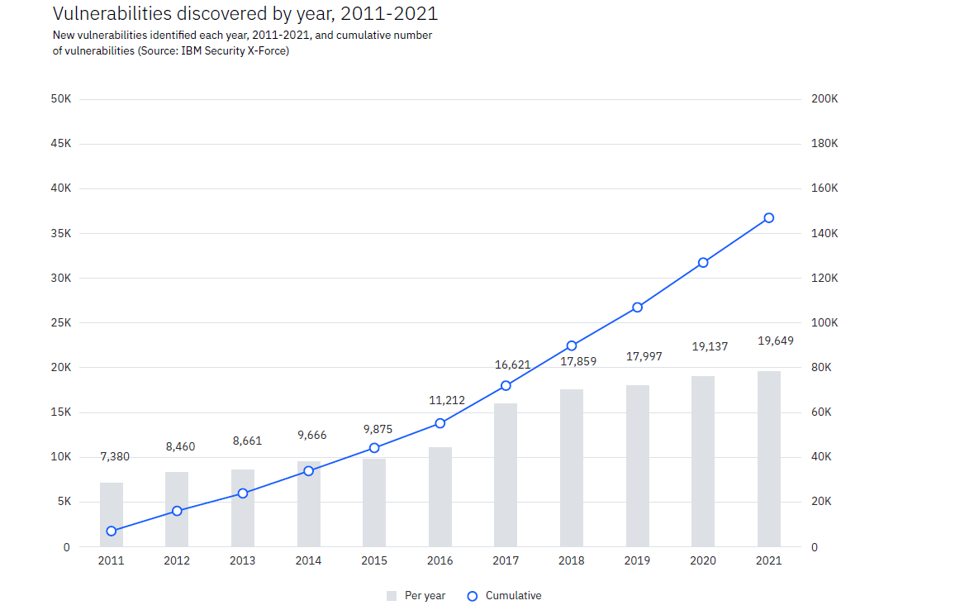
-PaloAlto Unit42 “2022 Ransomware Threat Report”

Slide 11
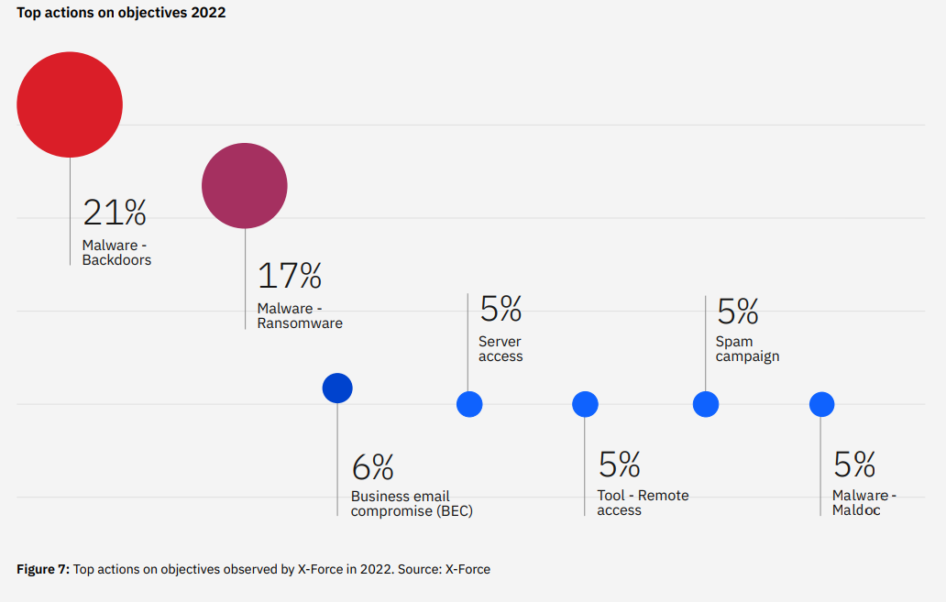
- IBM Security X-Force “Threat Intelligence Index 2023”
-PaloAlto Unit42 “2022 Ransomware Threat Report”

Slide 12
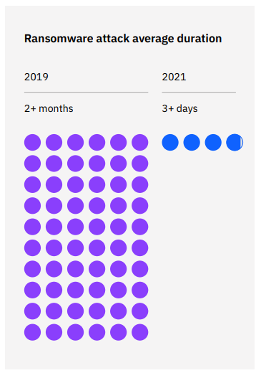
- IBM Security X-Force “Threat Intelligence Index 2023”
-PaloAlto Unit42 “2022 Ransomware Threat Report”

Slide 13
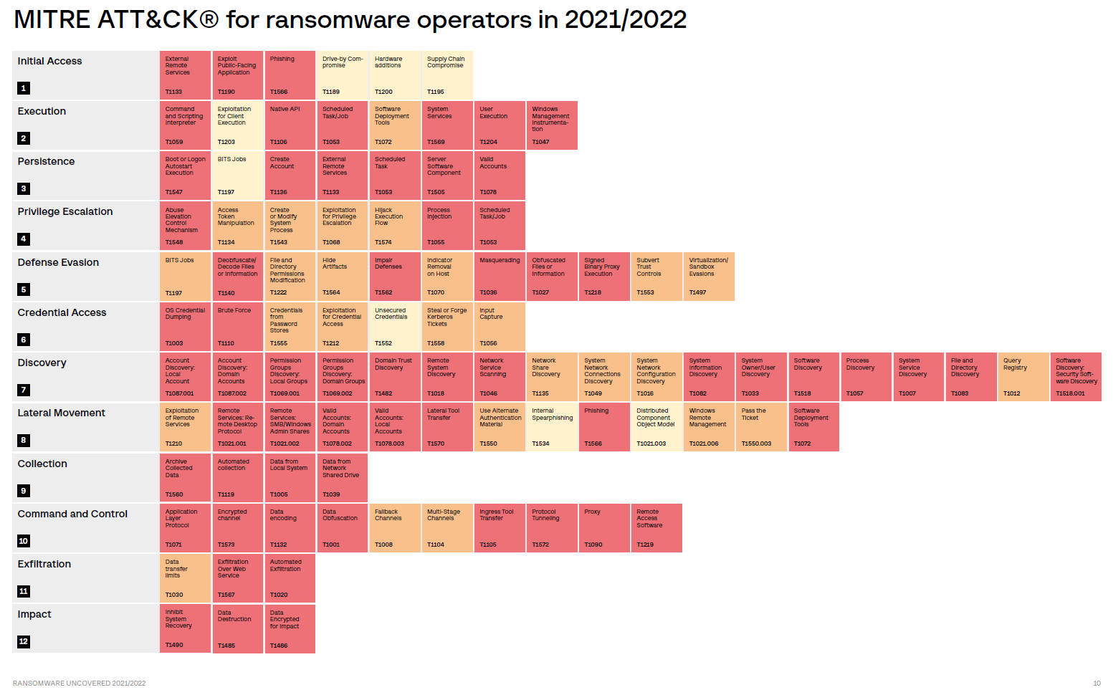
https://mitre-attack.github.io/attack-navigator/

Slide 14
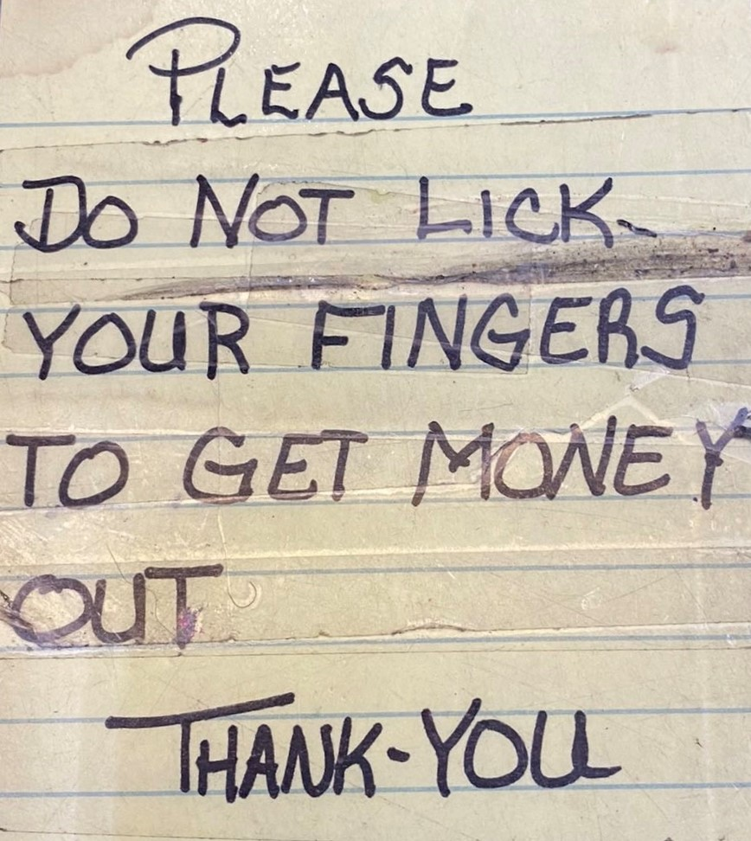
www.eidebailly.com/cybersecurity
Notes:
Its all about the money.
Per the National Park Service “Most squirrel bites originate at the front, or “bitey end,” of the squirrel.”
FBI Internet Crime Report 2022
https://www.ic3.gov/Media/PDF/AnnualReport/2022_IC3Report.pdf
In 2022, the IC3 received 21,832 BEC complaints with adjusted losses over $2.7 billion. BEC is a sophisticated scam targeting both businesses and individuals performing transfers of funds. The scam is frequently carried out when a subject compromises legitimate business email accounts through social engineering or computer intrusion techniques to conduct unauthorized transfers of funds.
In 2022, the IC3 received 2,385 complaints identified as ransomware with adjusted losses of more than $34.3 million. Ransomware is a type of malicious software, or malware, that encrypts data on a computer, making it unusable. In addition to encrypting the network, the cyber-criminal will often steal data off the system and hold that data hostage until the ransom is paid. If the ransom is not paid, the victim’s data remains unavailable.

Slide 15
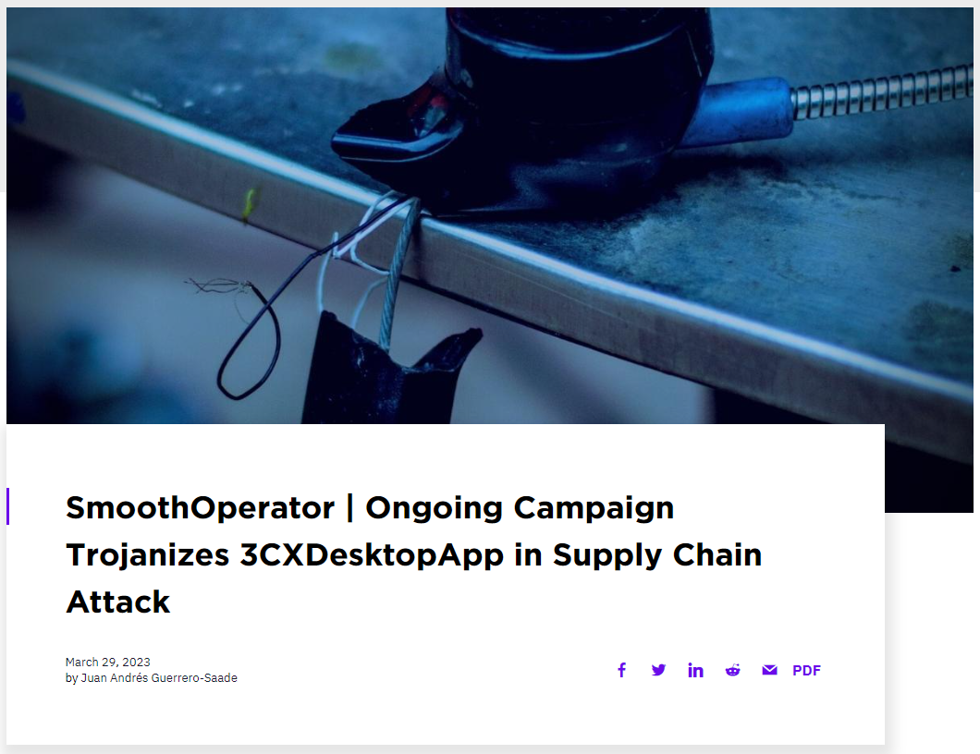
Notes:
https://www.sentinelone.com/blog/smoothoperator-ongoing-campaign-trojanizes-3cx-software-in-software-supply-chain-attack/
3CX is a VoIP IPBX software development company whose 3CX Phone System is used by more than 600,000 companies worldwide and has over 12 million daily users.
The company's customer list includes a long list of high-profile companies and organizations like American Express, Coca-Cola, McDonald's, BMW, Honda, Air France, Toyota, Mercedes-Benz, IKEA, and the UK's National Health Service (who published an alert on Thursday).
According to alerts from security researchers from Sophos and CrowdStrike, the attackers are targeting both Windows and macOS users of the compromised 3CX softphone app.
"The malicious activity includes beaconing to actor-controlled infrastructure, deployment of second-stage payloads, and, in a small number of cases, hands-on-keyboard activity," CrowdStrike's threat intel team said.
"The most common post-exploitation activity observed to date is the spawning of an interactive command shell," Sophos added in an advisory issued via its Managed Detection and Response service.
This supply chain attack, dubbed 'SmoothOperator' by SentinelOne, starts when the MSI installer is downloaded from 3CX's website or an update is pushed to an already installed desktop application.
This new malware is capable of harvesting system info and stealing data and stored credentials from Chrome, Edge, Brave, and Firefox user profiles.

Slide 16
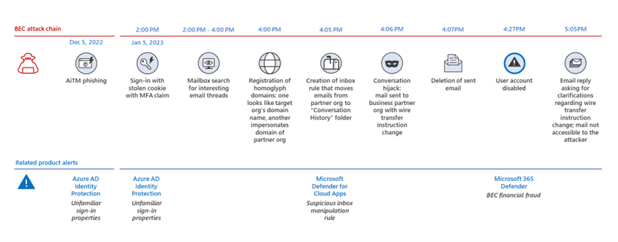
https://petri.com/microsoft-business-email-compromise-attacks/
Notes:
In the past year we’ve identified and detected numerous compromises where adversaries abuse valid credentials to silently modify a victim’s mailbox settings.
The intent is almost always to redirect specific emails of interest to places that legitimate users are unlikely to look. These incidents almost always unfolded in the same way: the adversary generated email inbox rules to filter and hide emails from the user by placing them in rarely used, built-in folders like “RSS Subscriptions,” “RSS Feeds,” or the “Archive” folder.
Adversaries then use the newly discovered information during their reconnaissance efforts to craft emails to the accounting or payroll departments Email threats 23 requesting to update direct deposit information or to otherwise redirect funds to accounts under their control.
We’ve also detected threats where the adversary creates inbox rules to automatically mark as read and move password reset emails.
The adversaries then remove all traces of their access by deleting the password reset emails and all of their newly created inbox rules. Of course, from a victim’s perspective the activity is silent, but with robust logging like the Microsoft Unified Audit Log, tracking the adversary’s moves is fairly easy.
The expedited timeline of these intrusions shows that adversaries spare no time in moving from initial access to their objectives. We’ve observed some incidents where the adversary makes their inbox modifications within minutes of compromising the account.
We’ve also witnessed adversaries waiting an extended period of time to carefully perform reconnaissance within the victim’s mailbox, sometimes holding off until the next day to make any direct changes to their account via inbox rules.
Confidently detecting the initial email account compromise is typically difficult, as it requires teams to detect anomalies to a user’s login behavior through a complicated series of alerting algorithms, potentially across numerous devices. As working from home becomes more commonplace—and bring-your-owndevice policies remain lax—very few security teams can keep up with the overwhelming number of false positives these signatures typically produce. Some identity alerting platforms take upwards of two days for their own machine learning algorithms to flag what they consider to be a “high-risk” login. By contrast, adversaries need just minutes to programmatically tackle their objectives.

Slide 17
https://techcommunity.microsoft.com/t5/microsoft-security-experts-blog/total-identity-compromise-dart-lessons-on-securing-active/ba-p/3753391
Notes:
For example, in the above kill chain, the first user was compromised due to a weak password policy. Through the initial poor password policy, additional bad credential hygiene, and ACL misconfiguration, the domain was compromised. When you multiply all the combinations of user accounts, group access, and permissions in Active Directory, many paths can exist to Domain Admin.
Attacks on Active Directory are ever evolving, and this blog covers only some of the more common issues DART observes in customer environments. Ultimately, any changes made to Active Directory can either increase or decrease the risk that a threat actor can take control of your environment. To ensure that risk is consistently decreasing, DART recommends a constant cycle of the below:
Reduce Privilege – assign all access according to the principle of least privilege. Additionally, deploy the enterprise access model to reduce privileged credential exposure. Combined, these will reduce the likelihood that a single device or user compromise leads to total domain compromise.
Audit Current Posture – use tools such as Defender for Identity and sanctioned use of BloodHound and PingCastle to audit your current Active Directory security posture and remediate the issues both surfaced through those tools and described in this blog.
Monitor Changes – monitor for changes to your Active Directory environment that can reduce your security posture or expose additional attack paths to domain compromise.
Actively Detect – alert on potential signs of compromise using Defender for Identity or custom detection rules.
A message that DART often leaves customers with is that securing Active Directory requires continued governance. You can’t ‘deploy’ Active Directory security and never have to look at it again. Active Directory security is about constant improvement and ensuring those misconfigurations and attack paths are mitigated before an adversary finds them.

Slide 18
Words About these Attacks
www.eidebailly.com/cybersecurity
Notes:
People process and technology solutions

Slide 19
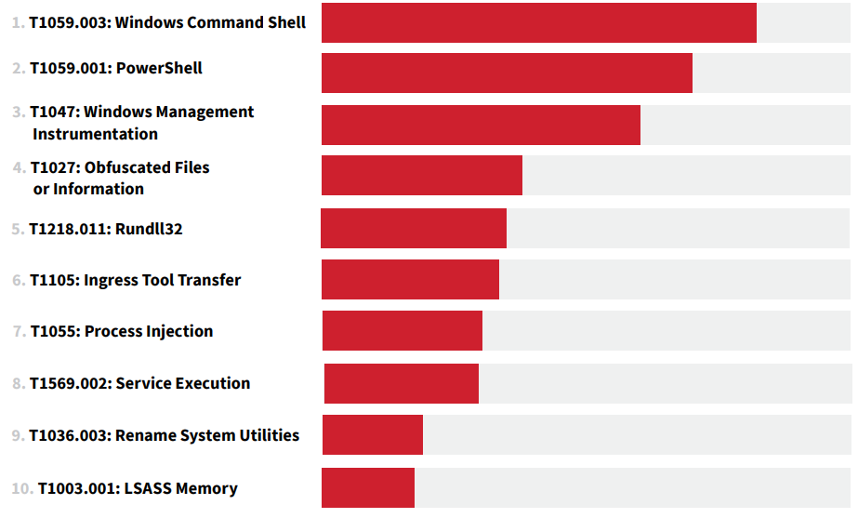
- Red Canary “2023 Threat Detection Report”

Slide 20
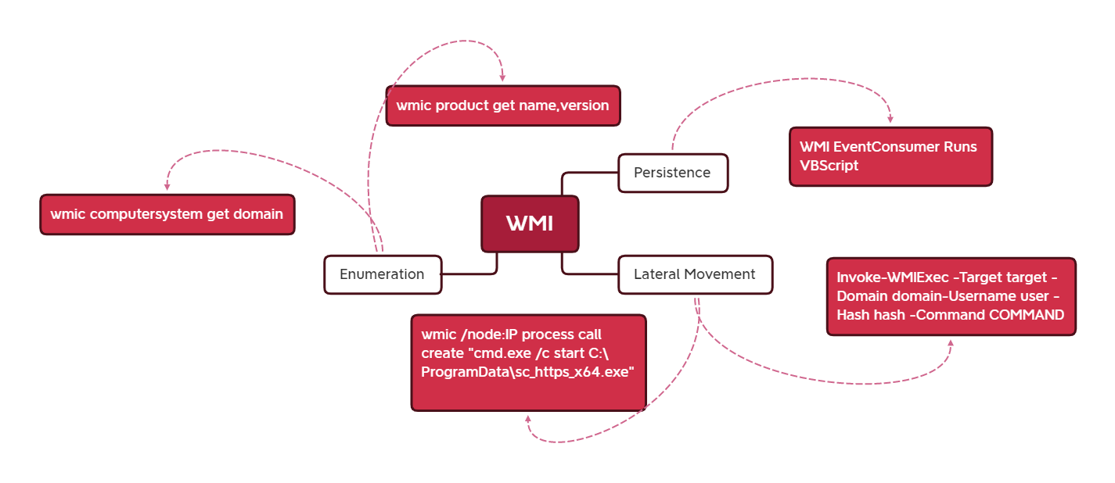

Slide 21
www.eidebailly.com/cybersecurity
Notes:
should be & is

Slide 22
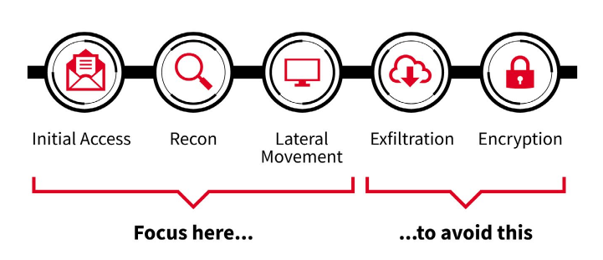
- Red Canary “2023 Threat Detection Report”

Slide 23
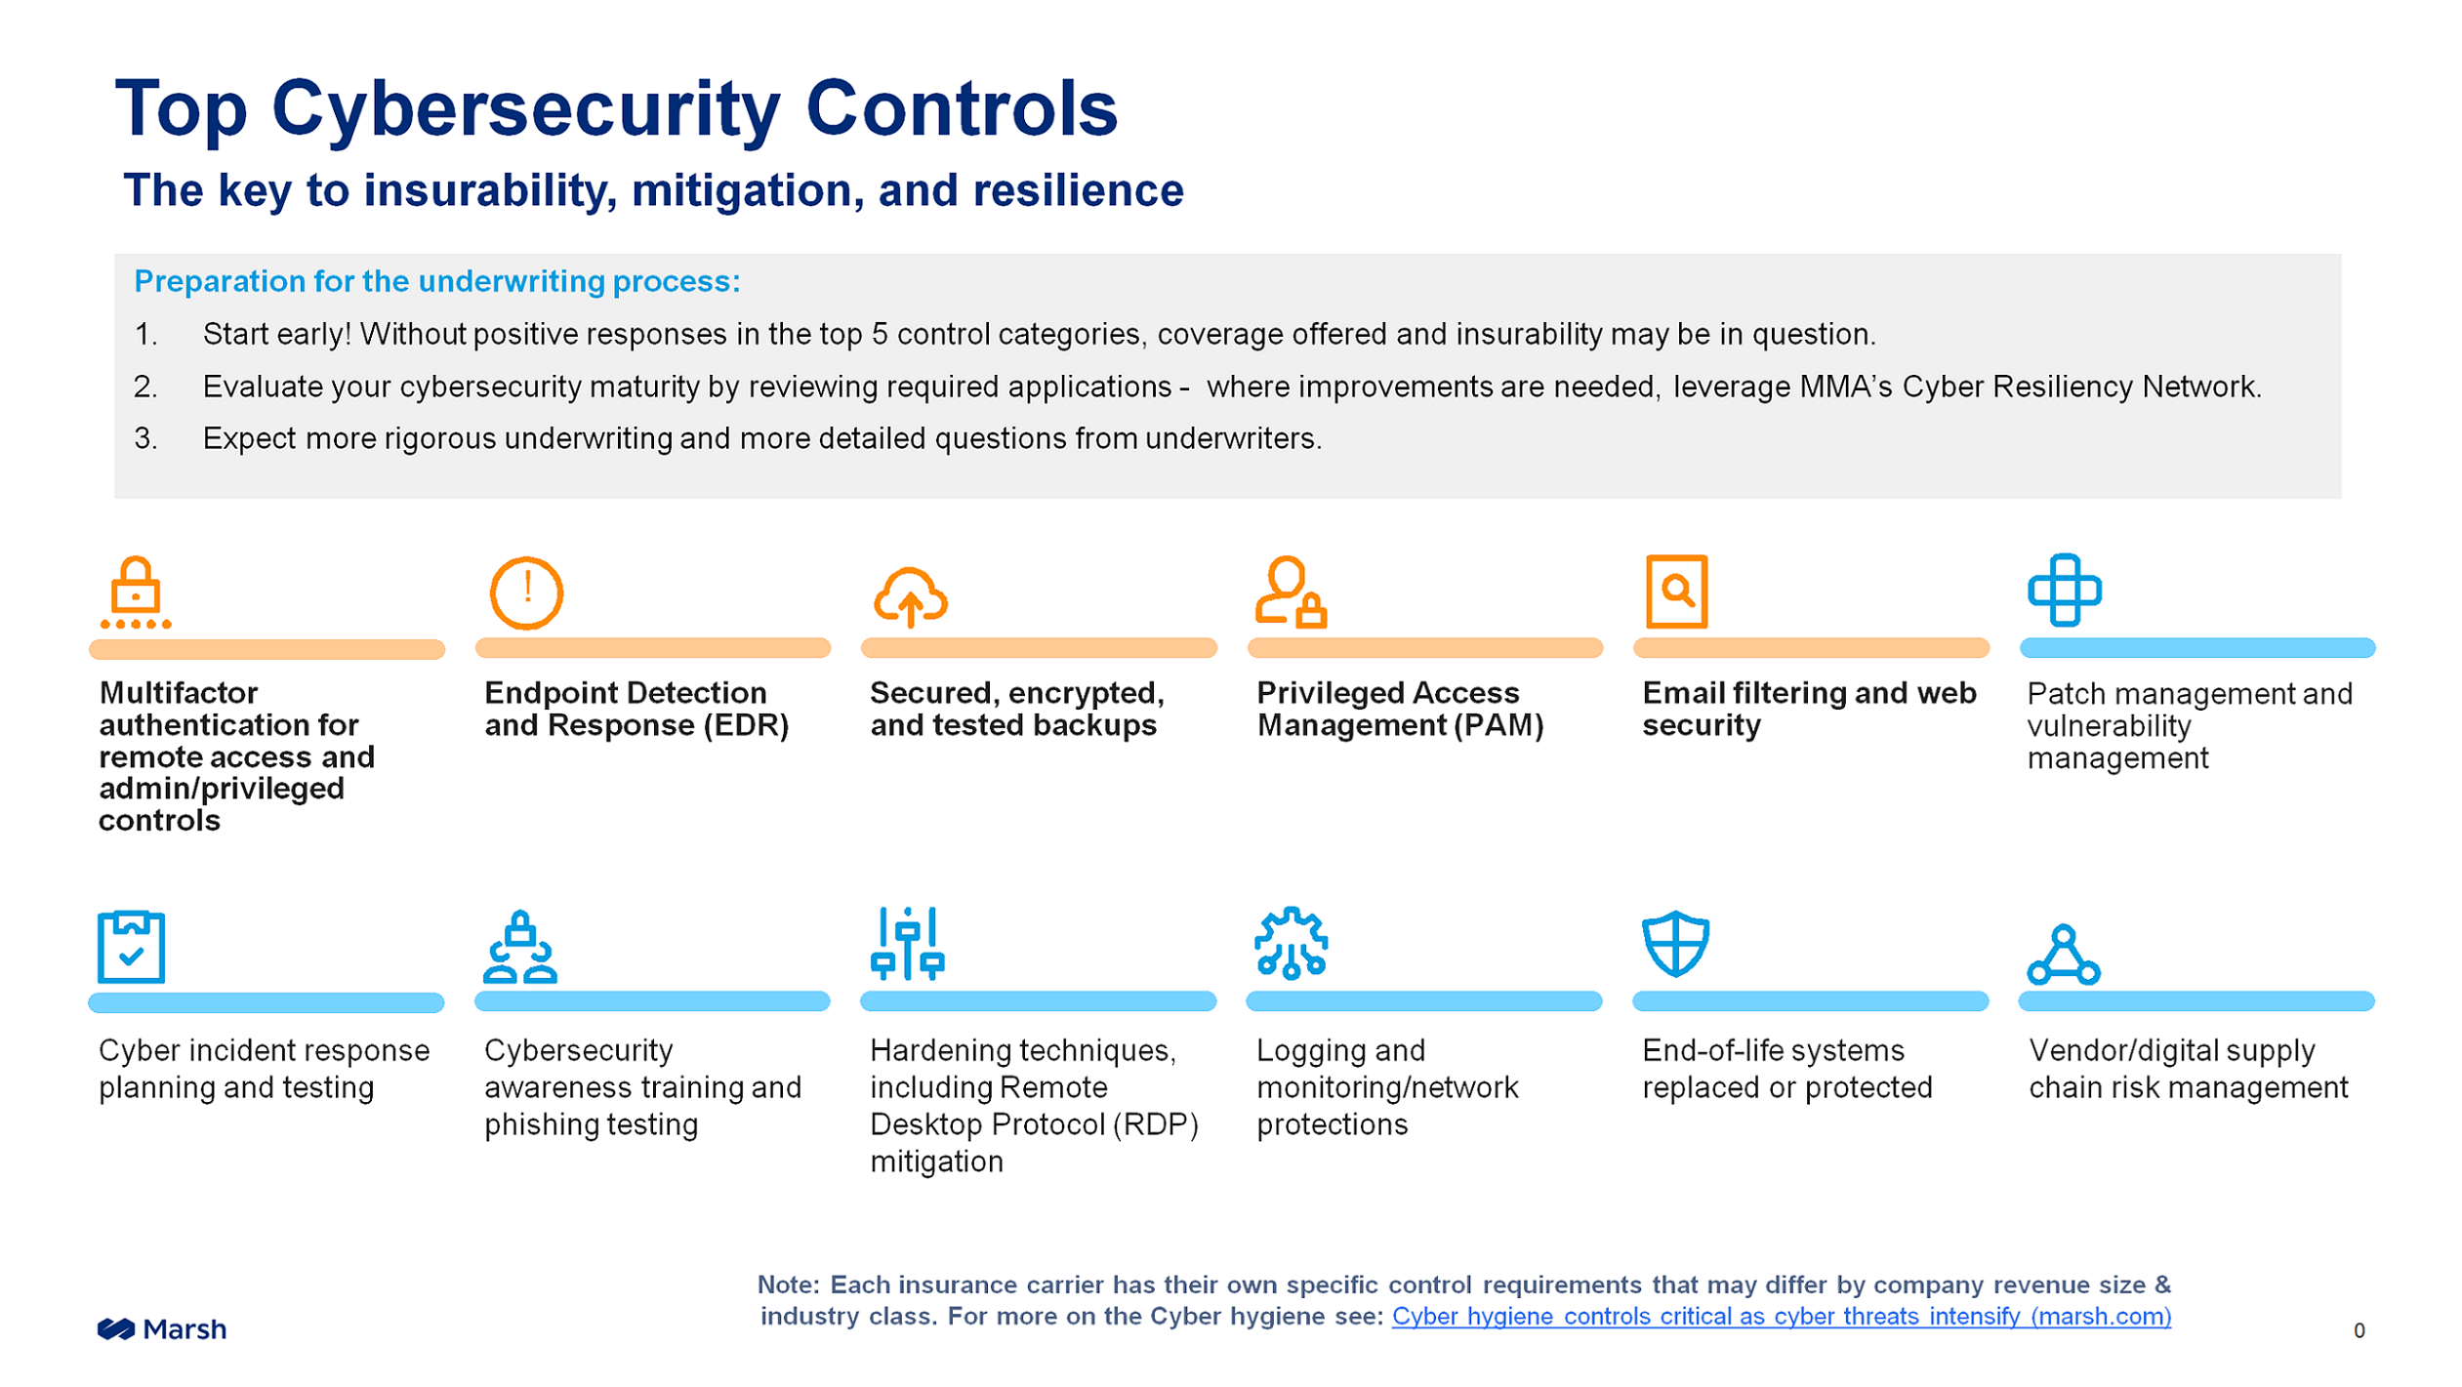
insurance
PAYROLL FRAUD
https://hbr.org/2022/03/the-cyber-insurance-market-needs-more-money
Notes:
Forcing the minium level of due care for cybersecurity

Slide 24
AI
www.eidebailly.com/cybersecurity
Notes:
People process and technology solutions

Slide 25
Compromise is inevitable, but It wont ever happen to me. Why? Because it’s never happened to me before.
www.eidebailly.com/cybersecurity
Notes:
People process and technology solutions

Slide 26
The savings of being prepared
Organizations that:
Have an IR team identified
Have an IR Plan
Exercise their Plan
spend 40% less on Data Breaches
www.eidebailly.com/cybersecurity
Notes:
The Savings of being prepared:
$3.29 million with team and exercised plan vs 5.29 million with NO plan or team.
How about a Business Continuity Plan (with a Disaster Recovery Plan) -- Not in place in your organization? If you don't have one… get one! You don't want to be left behind, when an incident occurs. They provide you with a strategic game plan when needed.
Do you have a trusted partner in the industry to help develop policies and plans for your organization to better safeguard you against cyber attacks?
Cost of a breach is 40% less

Slide 27
Notes:
When a hurricane makes landfall, the head of the Federal Emergency Management Agency relies on a couple of metrics to assess its destructive power.
First, there is the well-known Saffir-Simpson Wind Scale. Then there is what he calls the “Waffle House Index.”
Green means the restaurant is serving a full menu, a signal that damage in an area is limited and the lights are on. Yellow means a limited menu, indicating power from a generator, at best, and low food supplies. Red means the restaurant is closed, a sign of severe damage in the area or unsafe conditions.
“If you get there and the Waffle House is closed?” FEMA Administrator Craig Fugate has said. “That’s really bad. That’s where you go to work.”
The jump team sprang into action — its mission: Get the lights on and the grills simmering in the affected restaurants. Powerless stores were provided generators and gasoline, and propane for the grills. Water-less stores were given hundreds of bottles of water for drinking and boiling. Stores without employees had jump team members fill in roles while local workers attended to personal matters. Portable toilets were transported to restaurants without plumbing services. Construction sources were contacted and mobilized to heavily damaged restaurants. And about 40 food trucks rolled into the area to stock freezers.

Slide 28
Incident Response Process
Notes:
Detect and respond

Slide 29
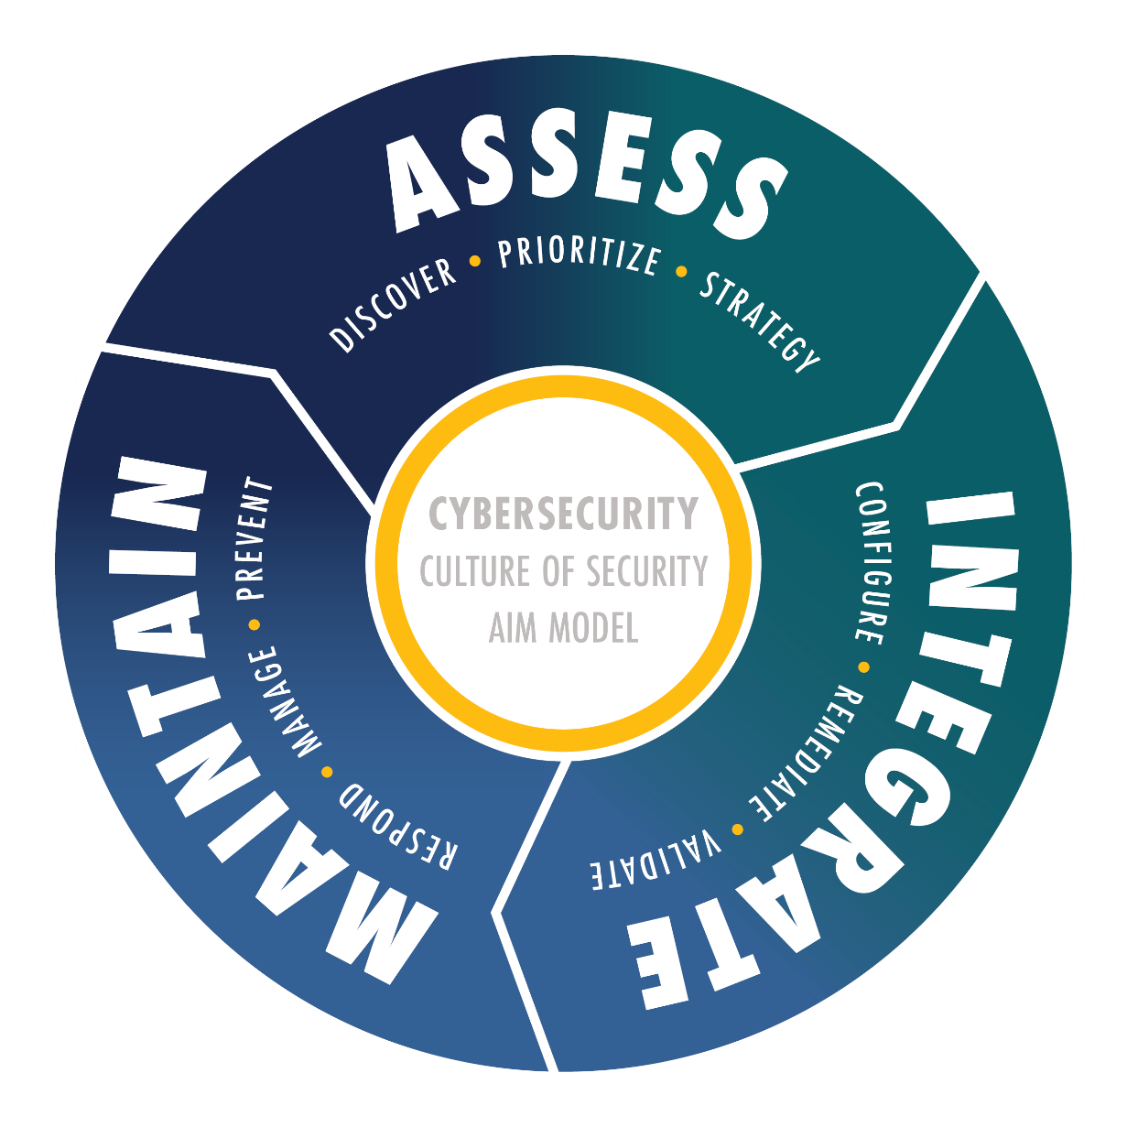
Cybersecurity Methodology
Notes:
Assess
Integrate
Maintain

Slide 30
-PaloAlto Unit42 “2022 Ransomware Threat Report”

Slide 31
Thank You!
Kyle Hendrickson Director of Cybersecurity khendrickson@eidebailly.com 701.239.8637
Notes:
Almost every business has someone that is being paid to open and click on email. We need to provide them with the education and controls structure needed for them to do their job safely.
Do you depend on email to communicate within your business? Reduce your attack surface, reduce the radius of things that can be affected when something bad happens.

Slide 32
www.eidebailly.com/cybersecurity

